Slide 1
网络安全技术
刘振
上海交通大学 计算机科学与工程系
电信群楼3-509
liuzhen@sjtu.edu.cn

Slide 2
1. Wallet
How to store and spend your bitcoins?
Each coin is a (address, value) pair on the (public) blockchain
Store the public key and corresponding secret signing key
$address→public key→secret key$
Use the signing key to spend the coin
Storing bitcoins is really all about storing and managing Bitcoin secret keys.
Security: making sure that nobody else can spend your coins.
Availability: being able to actually spend your coins when you want to.
Convenience: key management should be relatively easy to do.

Slide 3
1. Wallet
Simplest trivial way
storing them on a file on your own local device: your computer, your phone, or some other kind of gadget that you carry, or own, or control.
Convenience:
Security: If the device is stolen, …
Availability: If the device is lost, …
Wallet: A software or hardware that stores and manages the keys for the owner
Some additional features may be implemented to enhance security, availability, and/or convenience.
Image a wallet
How to have better security, availability, and/or convenience

Slide 4
1. Wallet
Wallet
A database storing the public keys and private keys
An interface that has the functionalities:
Tells the owner how many coins he has
Allows the owner to spend his coins
Helps the owner to generate new key pairs and the corresponding addresses
Show the owners’ transaction history
…
Use password to protect the keys from being known by unauthorized users
The keys are stored in encrypted form
Backup the wallet to the cloud
……

Slide 5
2. Deterministic Wallet
Deterministic Wallet
A wallet that all the key pairs can be deterministically from a `seed’
Master Public Key Property: the public keys can be derived from a master public key, without needing the (master) secret key(s)
Hierarchy Property : Each (public key, secret key) pair can act as the master key for its sub-organization. Useful for the large companies with hierarchical organizations
BIP32: Bitcoin standard, https://github.com/bitcoin/bips/blob/master/bip-0032.mediawiki
Electrum Wallet
https://electrum.org/
Almost each bitcoin-like cryptocurrency has or is planning to have a deterministic wallet.

Slide 6

2. Deterministic Wallet
Deterministic Wallet
Master Secret Key
$$msk≔s∈Z_{p}$$
Master public key
generation
Master Public Key
$$MPK≔sP∈G$$
$$p, G,$$
$$P∈G, H:{\left\{0,1\right\}}^{∗}→Z_{p}$$
secret key derivation
Public key derivation
i-th Secret Key
$$sk_{i}≔s+H(MPK,i)∈Z_{p}$$
Key pair
i-th Public Key
$$PK_{i}≔MPK+H\left(MPK,i\right)P ∈G$$
$$PK_{i}=sk_{i}P$$

Slide 7
2. Deterministic Wallet
Applications of Deterministic Wallet
Low-maintenance wallets with easy backup and recovery
Only need to back up the master secret key
Freshly generated cold addresses
Store the master public key on hot storage, then can easily and conveniently generate cold addresses
Merchant Web, each item with a different cold address
The wallet generates new address and tells the payer the new address
Trustless audit
Reveal the master public key to the auditors, then the auditors can view all the transactions related to the wallet
the coins are safe from the theft by the auditor
Hierarchical Wallet allowing a treasurer to allocate funds to departments
A treasurer of a large company creates child key pairs for each department within the company
the treasurer will have the master public/secret key for everything, but each department will only have the key to their own part of the funds
Hierarchical Wallet

Slide 8
2. Deterministic Wallet
Deterministic Wallet
What vulnerability does this algorithm has? Can it be used to simultaneously implement the treasurer and the auditor use cases?
Master Secret Key
$$msk≔s∈Z_{p}$$
Master public key
generation
Master Public Key
$$MPK≔sP∈G$$
$$p, G,$$
$$P∈G, H:{\left\{0,1\right\}}^{∗}→Z_{p}$$
secret key derivation
Public key derivation
i-th Secret Key
$$sk_{i}≔s+H(MPK,i)∈Z_{p}$$
Key pair
i-th Public Key
$$PK_{i}≔MPK+H\left(MPK,i\right)P ∈G$$
$$PK_{i}=sk_{i}P$$

Slide 9
3. Wallet vs Stealth Address
Wallet: Managing the keys for the wallet owner
Stealth address： to send money to a certain publicly visible master key in such a way that this key does not appear in the ledger at all, so that users’ privacy gets more protection.
While a wallet can require/assume that the master public key is kept secretly, stealth address much publish the master public key.

Slide 10

4. Stealth Address
$$p, G,$$
$$P∈G, H:{\left\{0,1\right\}}^{∗}→Z_{p}$$
The Payer
The Public
The Payee
$$(A=aG, B=bG)$$
$$\left(a, b\right)∈Z_{p}^{2}$$
$$r←_{R} Z_{p}$$
$$R=rG$$
$$S=H\left(rA\right)G+B$$
$$s=H\left(aR\right)+b$$
$$r_{1}←_{R} Z_{p}$$
$$R_{1}=r_{1}G$$
$$S_{1}=H\left(r_{1}A\right)G+B$$
$$s_{1}=H\left(aR_{1}\right)+b$$

Slide 11
4. Stealth Address Example
The system public parameters are $PP：=\left(p, G, P, H\right),$ where $G$ is an additive cyclic group of order $p$, $P∈G$ is a generator, $H:{\left\{0,1\right\}}^{∗}→Z_{p}$ is a secure cryptographic hash function.
The payee chooses random $a, b∈Z_{p},$ and sets master secret key and master public key
$MSK≔\left(a,b\right), MPK≔\left(A,B\right), where A=aG, B=bG$
When a payer wants to send coins to the payee, he can derive a fresh public key (address) from the payee’s long-term master public key:
Choose a random $r←Z_{p}$
Compute $R=rG, S=H\left(rA\right)G+B$
Use $\left(R,S\right)$ as the intended receiver’s address
The payee can scan the new blocks to find the transactions sending coins to him, and compute the secret key when necessary
Check whether $S=H\left(aR\right)G+B$
If the equation holds, compute $s=H\left(aR\right)+b$

Slide 12
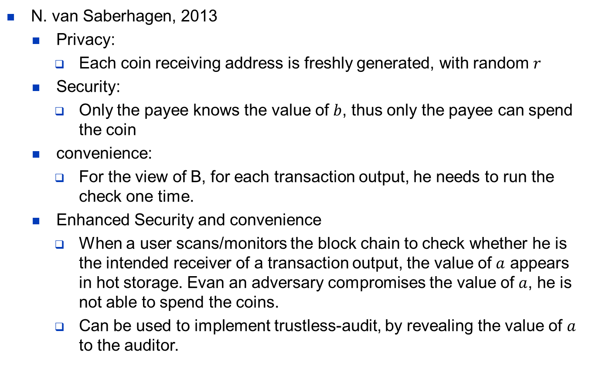
4. Stealth Address Example
N. van Saberhagen, 2013
Privacy:
Each coin receiving address is freshly generated, with random $r$
Security:
Only the payee knows the value of $b$, thus only the payee can spend the coin
convenience:
For the view of B, for each transaction output, he needs to run the check one time.
Enhanced Security and convenience
When a user scans/monitors the block chain to check whether he is the intended receiver of a transaction output, the value of $a$ appears in hot storage. Evan an adversary compromises the value of $a$, he is not able to spend the coins.
Can be used to implement trustless-audit, by revealing the value of $a$ to the auditor.

Slide 13
4. Stealth Address Example
The algorithm has been widely used in the community to implement stealth address.
Any vulnerability/flaw?

Slide 14
4. Stealth Address Example
$$p, G,$$
$$P∈G, H:{\left\{0,1\right\}}^{∗}→Z_{p}$$
The Payer
The Public
The Payee
$$(A=aG, B=bG)$$
$$\left(a, b\right)∈Z_{p}^{2}$$
$$r←_{R} Z_{p}$$
$$R=rG$$
$$S=H\left(rA\right)G+B$$
$$s=H\left(aR\right)+b$$
$$r_{1}←_{R} Z_{p}$$
$$R_{1}=r_{1}G$$
$$S_{1}=H\left(r_{1}A\right)G+B$$
$$s_{1}=H\left(aR_{1}\right)+b$$

Slide 15
4. Stealth Address Example
A security vulnerability: once a secret key is compromised, the master secret key may be compromised, and then other secret keys derived from the same master key are compromised.
Suppose Bob issued two transactions sending coins to Alice, with addresses $\left(R_{1},S_{1}\right) and (R_{2},S_{2})$ respectively, with $R_{i}=r_{i}G, S_{i}=H\left(r_{i}A\right)G+B, for i=1,2.$
If Bob compromises the secret key corresponding to $\left(R_{1},S_{1}\right)$ somehow, say $s_{1}=H\left(aR_{1}\right)+b$, then Bob can compute $b←s_{1}−H\left(r_{1}A\right),$since he knows the value of $r_{1}.$
Then Bob can compute $s_{2}←H\left(r_{2}A\right)+b$, since he also knows $r_{2}$.

Slide 16
Summary
Wallet
Deterministic Wallet and Its Flaw
Stealth Address
A widely used stealth address algotithm
Its Flaw

