Slide 1
Solutions Chapter 3

Slide 2
Exercise 3.6
In this exercise we will look at a couple of other ways to improve the performance of multiplication, based primarily on doing more shifts and fewer arithmetic operations. The following table shows pairs of hexadecimal numbers.
 | A | B
a. | 33 | 55
b. | 8a | 6d

Slide 3
3.6.1 As discussed in the text, one possible performance enhancement is to do a shift and add instead of an actual multiplication. Since 9×6, for example, can be written (2×2×2+1)×6， we can calculate 9×6 by shifting 6 to the left 3 times and then adding 6 to that result. Show the best way to calculate A×B using shifts and adds/subtracts. Assume that A and B are 8-bit unsigned integers.
Solution:
a.
0x33 × 0x55 = 0x10EF.
0x33 = 51, and 51 = 32 + 16 + 2 + 1.
We can shift 0x55 left 5 places (0xAA0), then add 0x55 shifted left 4 places (0x550), then add 0x55 shifted left once (0xAA), then add 0x55. 0xAA0 + 0x550 + 0xAA + 0x55 = 0x10EF.
3 shifts, 3 adds.
 | A | B
a. | 33 | 55
b. | 8a | 6d

Slide 4
Solution:
b.
0x8A × 0xED = 0x7FC2
0x8A = 128 + 8 + 2
0xED = 128 + 64 + 32 + 8 + 4 + 1.
Best way is to shift 0xED left 7 places (0x7680), then add to that 0xED shifted left 3 places (0x768), and then add 0xED shifted left 1 place (0x1DA).
3 shifts, 2 adds.
 | A | B
a. | 33 | 55
b. | 8a | 6d

Slide 5
3.6.2 Show the best way to calculate A×B using shifts and add, if A and B are 8-bit signed integers stored in sign-magnitude format.
Solution:
a.
0x33 × 0x55 = 0x10EF.
0x33 = 51, and 51 = 32 + 16 + 2 + 1.
We can shift 0x55 left 5 places (0xAA0), then add 0x55 shifted left 4 places (0x550), then add 0x55 shifted left once (0xAA), then add 0x55.
0xAA0 + 0x550 + 0xAA + 0x55 = 0x10EF.
3 shifts, 3 adds.
 | A | B
a. | 33 | 55
b. | 8a | 6d

Slide 6
Solution:
b.
0x8A × 0xED = –0x0A × –0x6D = 0x442
0x0A = 8 + 2,
0x6D = 64 + 32 + 8 + 4 + 1.
Best way is to shift 0x6D left 3 places (0x368), then add to that 0x6D shifted left 1 place (0xDA).
2 shifts, 1 add.
 | A | B
a. | 33 | 55
b. | 8a | 6d

Slide 7
3.6.3 Write an MIPS assembly language program that perform a multiplication on signed integers using shifts and adds, using the approach described in 3.6.1.
Solution:
No solution provided.

Slide 8
The following table shows further pairs of hexadecimal numbers.
 | A | B
a. | f6 | 7f
b. | 08 | 55

Slide 9
3.6.4 Booth’s algorithm is another approach to reducing the number of arithmetic operations necessary to perform a multiplication. This algorithm has been around for years and involves identifying runs of ones and zeros and performing only shifts instead of shifts and adds during the runs. Fing a description of the algorithm on the web and explain in detail how it works.
Solution:
Quoting the Wikipedia entry directly:
Booth’s algorithm involves repeatedly adding one of two predetermined values A and S to a product P, then performing a rightward arithmetic shift on P. Let x and y be the multiplicand and multiplier, respectively; and let x and y represent the number of bits in x and y.

Slide 10
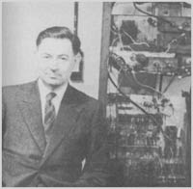
Booth's Algorithm
A multiplication algorithm that multiplies two signed
binary numbers in two's complement notation.
Invented by Andrew Donald Booth in 1951 while doing
research on crystallography at Birkbeck College in
Bloomsbury, London.

Slide 11
Booth's Algorithm- Rules
For each multiplier bit, also examine bit to its right
• 00: middle of a run of 0s, do nothing
• 10: beginning of a run of 1s, subtract multiplicand
• 11: middle of a run of 1s, do nothing
• 01: end of a run of 1s, add multiplicand

Slide 12
Booth's Algorithm- why?
Why Booth’s Algorithm holds?
Given [X]_{2’com}=x_{n-1}x_{n-2}…… x₁x_{0 ，} [ Y]_{2’com}=y_{n-1}y_{n-2}…… y₁y_{0 ,} calculate[X x Y]_{2’com}=？
Based on 2’s complement, we have
Y=-y_{n-1}.2^{n-1}+y_{n-2} .2^{n-2}+ …… y₁ .2¹+ y₀ .2⁰
Let y₋₁ =0，so：
When n=32，Y=-y₃₁.2³¹+y₃₀ .2³⁰+ …… y₁ .2¹+ y₀.2⁰ + y₋₁ .2⁰
-y₃₁.2³¹+(y₃₀.2³¹-y₃₀.2³⁰)+…… +(y₀.2¹-y₀.2⁰)+ y₋₁.2⁰
(y₃₀ -y₃₁ ).2³¹+(y₂₉-y₃₀).2³⁰+ …… + (y₀–y₁).2¹ +(y₋₁-y₀).2⁰
2^{-32.}[XxY]_{补}= (y₃₀ -y₃₁ )X.2⁻¹+(y₂₉-y₃₀)X.2⁻²+ …… + (y₀–y₁)X.2⁻³¹ +(y₋₁-y₀) X.2⁻³²
= 2⁻¹(2⁻¹…(2⁻¹(y₋₁-y₀)X) + (y₀–y₁)X) +… + (y₃₀ -y₃₁)X)

Slide 13
Points to remember
When using Booth's Algorithm:
You will need twice as many bits in your product as you have in your original two operands.
The leftmost bit of your operands (both your multiplicand and multiplier) is a SIGN bit, and cannot be used as part of the value.

Slide 14
3.6.5 Show the step-by-step result of multiplying A and B, using Booth’s algorithm. Assume A and B are 8-bit two’s complement integers, stored in hexadecimal format.

Slide 15
Solution:
a. 0xF6 × 0x7F = −0xA × 0x7F = −10 × 127
= −1270 = 0xFB0A
Action | Multiplicand | Product/Multiplier
Initial Vals | 1111 0110 | 0000 0000 0111 1111 0
10, subtract shift | 1111 0110 1111 0110 | 0000 1010 0111 1111 0 0000 0101 0011 1111 1
11, nop shift | 1111 0110 1111 0110 | 0000 0101 0011 1111 1 0000 0010 1001 1111 1
11, nop shift | 1111 0110 1111 0110 | 0000 0010 1001 1111 1 0000 0001 0100 1111 1
11, nop shift | 1111 0110 1111 0110 | 0000 0001 0100 1111 1 0000 0000 1010 0111 1
11, nop shift | 1111 0110 1111 0110 | 0000 0000 1010 0111 1 0000 0000 0101 0011 1
11, nop shift | 1111 0110 1111 0110 | 0000 0000 0101 0011 1 0000 0000 0010 1001 1
11, nop shift | 1111 0110 1111 0110 | 0000 0000 0010 1001 1 0000 0000 0001 0100 1
01, add shift | 1111 0110 1111 0110 | 1111 0110 0001 0100 1 1111 1011 0000 1010 0

Slide 16
Solution:
b. 0x08 × 0x55 = 0x2A8
Action | Multiplicand | Product/Multiplier
Initial Vals | 0000 1000 | 0000 0000 0101 0101 0
10, subtract shift | 0000 1000 0000 1000 | 1111 1000 0101 0101 0 1111 1100 0010 1010 1
01, add shift | 0000 1000 0000 1000 | 0000 0100 0010 1010 1 0000 0010 0001 0101 0
10, subtract shift | 0000 1000 0000 1000 | 1111 1010 0001 0101 0 1111 1101 0000 1010 1
01, add shift | 0000 1000 0000 1000 | 0000 0101 0000 1010 1 0000 0010 1000 0101 0
10, subtract shift | 0000 1000 0000 1000 | 1111 1010 1000 0101 0 1111 1101 0100 0010 1
01, add shift | 0000 1000 0000 1000 | 0000 0101 0100 0010 1 0000 0010 1010 0001 1
10, subtract shift | 0000 1000 0000 1000 | 1111 1010 1010 0001 0 1111 1101 0101 0000 1
01, add shift | 0000 1000 0000 1000 | 0000 0101 0101 0000 1 0000 0010 1010 1000 1

Slide 17
3.6.6 Write an MIPS assembly language program to perform the multiplication of A and B using Booth’s algorithm.
Solution:
http://code.google.com/p/mips-booth-multiplication/source/browse/trunk/booth.asm?r=9

Slide 18
Exercise 3.8
Figure 3.10 describes a restoring division algorithm, because when subtracting the divisor from the remainder produces a negative result, the divisor is added back to the remainder (thus restoring the value). However, there are other algorithms that have been developed that eliminate the extra addition. Many references to these algorithms are easily found on the web. We will explore these algorithms using the pairs of octal numbers in the following table.
 | A | B
a. | 26 | 05
b. | 37 | 15

Slide 19
3.8.1 Using a table similar to that shown in Figure 3.11, calculate A divided by B using non-restoring division. You should show the contents of each register on each step. Assume A and B are 6-bit unsigned integers.

Slide 20
Solution:
a. 26/05 = 5 remainder 1

Slide 21
Solution:
b. 37/15 = 2 remainder 7

Slide 22
3.8.2 Write an MIPS assembly language program to calculate A divided by B using non-restoring division. You should show the contents of each register on each step. Assume A and B are 6bit unsigned integers.
Solution:
No solution provided.

Slide 23
3.8.3 How does the performance of restoring and non-restoring division compare? Demonstrate by showing the number of steps necessary to calculate A divided by B using each method. Assume A and B are 6-bit signed (sign-magnitude) integers. Writing a program to perform the restoring and non-restoring divisions is acceptable.
Solution:
No solution provided.

Slide 24
The following table shows further pairs of numbers.
 | A | B
a. | 27 | 06
b. | 54 | 12

Slide 25
3.8.5 Write an MIPS assembly language program to calculate A divided by B using nonperforming division. Assume A and B are 6-bit two’s complement signed integers.
Solution:
No solution provided.

Slide 26
3.8.6 How does the performance of non-restoring and nonperforming division compare? Demonstrate by showing the number of steps necessary to calculate A divided by B using each method. Assume A and B are signed 6-bit integers, stored in sign-magnitude format. Writing a program to perform the nonperforming and non-restoring division is acceptable.
Solution:
No solution provided.

Slide 27
Exercise 3.11
In the IEEE 754 floating point standard the exponent is stored in “bias” (also known as Excess-N) format. This approach was selected because we want an all-zero pattern to be as close to zero as possible. Because of the use of a hidden 1, if we were to represent the exponent in two’s complement format an all-zero pattern would actually be the number 1! (Remember, anything raised to the zeroth power is 1, so 1.0⁰=1.) There are many other aspects of the IEEE 754 standard that exist in order to help hardware floating point units work more quickly. However, in many older machines floating point calculations were handled in software, and therefore other formats were used. The following table shows decimal numbers.
a. | -1.5625×10⁻¹ | b. | 9.356875×10²

Slide 28
3.11.1 Write down the binary bit pattern assuming a format similar to that employed by the DEC PDP-8 (the leftmost 12 bits are the exponent stored as a two’s complement number, and the rightmost 24 bits are the mantissa stored as a two’s complement number). No hidden 1 is used. Comment on how the range and accuracy of this 36-bit pattern compares to the single and double precision IEEE 754 standards.

Slide 29
Representation range of IEEE 754 single precision
Sign Exponent Fraction
1 bit 8 bits 23 bits
S
E
F
Negative numbers less than -(2-2⁻²³) × 2¹²⁷ (negative overflow)
to -1 * 2¹⁻¹²⁷ (negative underflow) Normalized
Zero
to 1 * 2¹⁻¹²⁷ (positive underflow) Normalized
Positive numbers greater than (2-2⁻²³) × 2¹²⁷ (positive overflow)

Slide 30
Representation range of IEEE 754 Double Precision
Sign Exponent Fraction
1 bit 11 bits 52 bits
S
E
F
30
Negative numbers less than -(2-2⁻⁵²) × 2¹⁰²³ (negative overflow)
To -1 * 2¹⁻¹⁰²³ (negative underflow) Normalized
Zero
Or 1 * 2¹⁻¹⁰²³ (positive underflow) Normalized
Positive numbers greater than (2-2⁻⁵²) × 2¹⁰²³ (positive overflow)

Slide 31
Representation range of PDP-8
Exponent Fraction
12 bits 24 bits
E
F
Exponent: -2¹¹ to 2¹¹ -1
Mantissa: [-(2-2⁻²² ), -1]to [1, 2-2⁻²² ]
Largest number (2-2⁻²²)*2²⁰⁴⁷
Smallest positive number (1)* 2⁻²⁰⁴⁸
zero
Largest negative number (-1)* 2⁻²⁰⁴⁸
Smallest negative number - (2-2⁻²²)*2²⁰⁴⁷
c. Exponent: 127 vs 1023 vs 2047 (or 8 bit vs 11 bit vs 12 bit)
Significant: 23 vs 52 vs 23 (or 23 bit vs 52 bit vs 23 bit )

Slide 32
3.11.2 NVIDIA has a “half” format, which is similar to IEEE 754 except that it is only 16 bits wide. The leftmost bit is still the sign bit, the exponent is 5 bits wide and stored in excess-56 format, and the mantissa is 10 bits long. A hidden 1 is assumed. Write down the bit pattern assuming a modified version of this format, which uses an excess-16 format to store the exponent. Comment on how the range and accuracy of this 16-bit floating point format compares to the single precision IEEE 754 standard.

Slide 33
Representation range of NVIDIA
Sign Exponent Fraction
1 bit 5 bits 10 bits
S
E
F
Negative numbers less than -(2-2⁻¹⁰) × 2¹⁵ (negative overflow)
Negative numbers greater than -1*2⁻¹⁵ (negative underflow)
Zero
Positive numbers less than 1*2⁻¹⁵ (positive underflow)
Positive numbers greater than (2-2⁻¹⁰) × 2¹⁵ (positive overflow)

Slide 34
3.11.3 The Hewlett-Packard 2114, 2115, and 2116 used a format with the leftmost 16 bits being the mantissa stored in two’s complement format, followed by another 16-bit field which had the leftmost 8 bits as an extension of the mantissa (making the mantissa 24 bits long), and the rightmost 8 bits representing the exponent. However, in an interesting twist, the exponent was stored in sign-magnitude format with the sign bit on the far right! Write down the bit pattern assuming this format. No hidden 1 is used. Comment on how the range and accuracy of this 32-bit pattern compares to the single precision IEEE 754 standard.

Slide 35
Representation range of HP
Fraction Fraction Exponent Sign
16 bit 8 bits 7 bits 1
F
F
E
S
Negative numbers less than -(2-2⁻²²) × 2¹²⁸ (negative overflow)
Negative numbers greater than -1*2⁻¹²⁸ (negative underflow)
Zero
Positive numbers less than 1*2⁻¹²⁸ (positive underflow)
Positive numbers greater than (2-2⁻²²) × 2¹²⁸ (positive overflow)
c. Exponent: 7 bit vs 7 bit
Significant: 23 bit vs 22 bit

Slide 36
The following table shows pairs of decimal numbers.
 | A | B
a. | 2.6125×10⁻¹ | 4.150390625×10⁻¹
b. | -4.484375×10¹ | 1.3953125×10¹

Slide 37
3.11.4 Calculate the sum of A and B by hand, assuming A and B are stored in the modified 16-bit NVIDIA format described in 3.11.2. Assume 1 guard, 1 round bit, and 1 sticky bit, and round to the nearest even. Show all the steps.
Sign Exponent Fraction
1 bit 5 bits 10 bits
S
E
F

Slide 38
Solution:
a.
2.6125×10¹ + 4.150390625×10^{–1}
2.6125×10¹ = 26.125 = 11010.001 = 1.1010001000×2⁴
4.150390625×10^{–1} = .4150390625 = .011010100111
=1.1010100111×2^{–2}
Shift binary point 6 to the left to align exponents,
GR
1.1010001000 00
+.0000011010 10 0111 (Guard = 1, Round = 0, Sticky = 1)
--------------------
1.1010100010 10
In this case the extra bits (G,R,S) are more than half of the least significant bit (0).
Thus, the value is rounded up.
1.1010100011 × 2⁴ = 11010.100011 × 2⁰ = 26.546875
= 2.6546875 × 10¹

Slide 39
Solution:
b.
–4.484375 × 10¹ + 1.3953125 × 10¹
–4.484375 × 10¹ = –44.84375 = –1.0110011011 × 2⁵
1.1953125 × 10¹ = 11.953125 = 1.0111111010 × 2³
Shift binary point 2 to the left and align exponents,
GR
–1.0110011011 00
0.0101111110 10 (Guard = 1, Round = 0, Sticky = 0)
------------------
–1.0000011100 10
In this case, the Guard is 1 and the Round and Sticky bits are zero. This is the “exactly half” case—if the LSB was odd (1) we would add, but since it is even (0) we do nothing.
–1.0000011100 × 2⁵ = –100000.11100 × 2⁰ = –32.875
= –3.2875 × 10¹

Slide 40
3.11.5 Write an MIPS assembly language program to calculate the sum of A and B, assuming they are stored in the modified 16-bit NVIDIA format described in 3.11.2. Assume 1 guard, 1 round bit, and 1 sticky bit, and round to the nearest even.
Solution:
No solution provided.

Slide 41
3.11.6 Write an MIPS assembly language program to calculate the sum of A and B, assuming they are stored using the format described in 3.11.1. Now modify the program to calculate the sum assuming the format described in 3.11.3. Which format is easier for a programmer to deal with? How do they each compare to the IEEE 754 format? (Do not worry about sticky bits for this question.)
Solution:
No solution provided.

Slide 42
Exercise 3.14
The associative law is not the only one that does not always hold in dealing with floating point numbers. There are other oddities that occur as well. The following table shows sets of decimal numbers.
 | A | B | C
a. | 1.666015625×10⁰ | 1.9760×10⁴ | -1.9744×10⁴
b. | 3.48×10² | 6.34765625×10⁻² | -4.052734375×10⁻²

Slide 43
3.14.1 Calculate A×(B+C) by hand, assuming A, B, and C are stored in the modified 16-bit NVIDIA format described in 3.11.2 (and also described in the text). Assume 1 guard, 1 round bit, and 1 sticky bit, and round to the nearest even. Show all the steps, and write your answer in both the 16-bit floating point format and in decimal.

Slide 44
Solution:
a.
1.666015625 × 10⁰ × (1.9760 × 10⁴ – 1.9744 × 10⁴)
(A) 1.666015625 × 10⁰ = 1.1010101010 × 2⁰
(B) 1.9760 × 10⁴ = 1.0011010011 × 2¹⁴
(C) –1.9744 × 10⁴ = –1.0011010010 × 2¹⁴
Exponents match, no shifting necessary
(B) 1.0011010011
(C) –1.0011010010
---------------
(B+C) 0.0000000001 × 2¹⁴
(B+C) 1.0000000000 × 2⁴
Exp: 0 + 4 = 4
Signs: both positive, result positive

Slide 45
Solution:
a.
Mantissa:
(A) 1.1010101010
(B+C) × 1.0000000000
------------
11010101010
----------------------
1.10101010100000000000
A×(B+C) 1.1010101010 0000000000
Guard=0, Round=0, Sticky=0: No Round
A (B+C) 1.1010101010 × 2⁴

Slide 46
Solution:
b.
3.48 × 10² × (6.34765625 × 10^{–2} – 4.052734375 × 10^{–2})
(A) 3.48 × 10² = 1.0101110000 × 2⁸
(B) 6.34765625 × 10^{–2} = 1.0000010000 × 2^{–4}
(C) –4.052734375 × 10^{–2} = 1.0100110000 × 2^{–5}
Shift binary point of smaller left 1 so exponents match
(B) 1.0000010000 × 2^{–4}
(C) –.1010011000 0 × 2^{–4}
---------------
(B+C) .0101111000 Normalize, subtract 2 from exponent
(B+C) 1.0111100000 × 2^{–6}
Exp: 8 – 6 = 2
Signs: both positive, result positive

Slide 47
Solution:
b.
Mantissa:
(A) 1.0101110000
(B + C) × 1.0111100000
------------
10101110000
10101110000
10101110000
10101110000
10101110000
A×(B+C) 1.1111111100 10000000000
Guard=1, Round=0, Sticky=0:Round to even
A × (B + C) 1.1111111100 × 2²

Slide 48
3.14.2 Calculate (A×B)+(A×C) by hand, assuming A, B, and C are stored in the modified 16-bit NVIDIA format described in 3.11.2 (and also described in the text). Assume 1 guard, 1 round bit, and 1 sticky bit, and round to the nearest even. Show all the steps, and write your answer in both the 16-bit floating point format and in decimal.

Slide 49
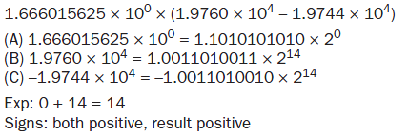
Solution:
a.

Slide 50
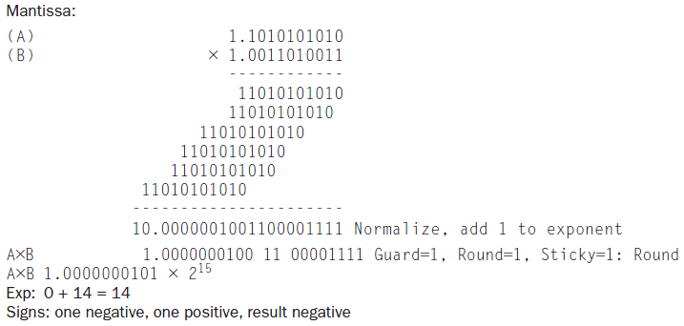
Solution:
a.

Slide 51
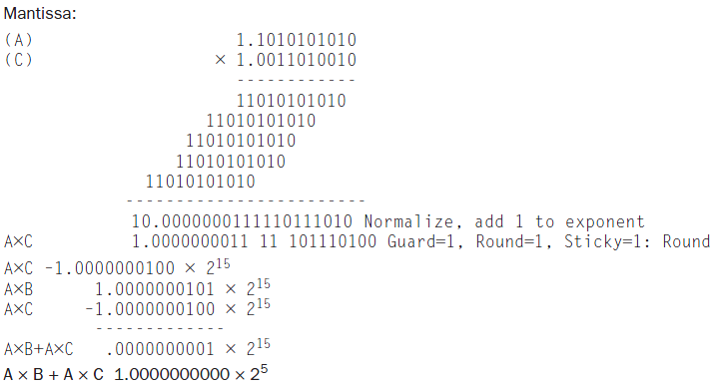
Solution:
a.

Slide 52
Solution:
b.

Slide 53
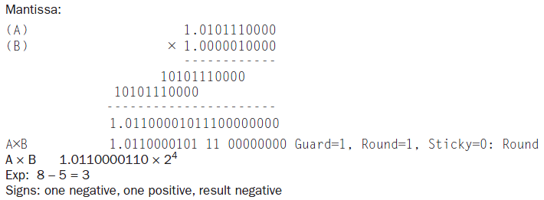
Solution:
b.

Slide 54
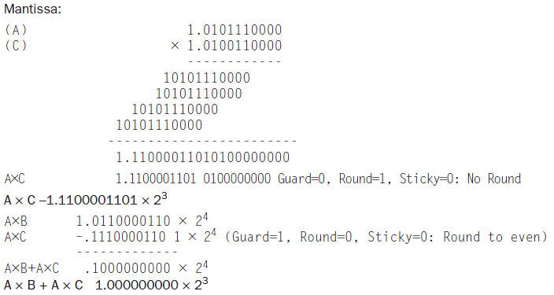
Solution:
b.

Slide 55
3.14.3 Based on your answers to 3.14.1 and 3.14.2, does (A×B)+(A×C) = A×(B+C)?
Solution:
a. No
A × (B + C) = 1.1010101010 × 2⁴ = 26.65625
(A × B) + (A × C) = 1.0000000000 × 2⁵ = 32
Exact: 1.666015625 × (19760 – 19744) = 26.65625
b. No
A × B + A × C = 1.0000000000 × 2³ = 8
A × (B + C) = 1.1111111100 × 2² = 7.984375
Exact: 348 × (.0634765625 – .04052734375) = 7.986328125

Slide 56
The following table shows pairs, each consisting of a fraction and an integer.
 | A | B
a. | -1/4 | 4
b. | 1/10 | 10

Slide 57
3.14.4 Using the IEEE 754 floating point format, write down the bit pattern that would represent A. Can you represent A exactly?
Solution:
 | Answer | Sign | Exp | Exact?
a. | 1 01111101 00000000000000000000000 | - | -2 | Yes
b. | 0 01111011 10011001100110011001101 | + | -4 | No

Slide 58
3.14.5 What do you get if you add A to itself B times? What is A×B? Are they the same? What should they be?
Solution：
a.
b + b + b + b = –1
b × 4 = –1
They are the same
b.
e + e + e + e + e + e + e + e + e + e
= 1.000000000000000000000100
e × 10 = 1.000000000000000000000100

Slide 59
3.14.6 What do you get if you take the square root of B and then multiply that value by itself? What should you get? Do for both single and double precision floting point numbers. (Write a program to do these calculations.)
Solution:
No solution provided.

