Slide 1
网络安全技术
刘振
上海交通大学 计算机科学与工程系
电信群楼3-509
liuzhen@sjtu.edu.cn

Slide 2
Introduction to Bitcoin

Slide 3
1. What is Bitcoin？
What is Bitcoin？
A digit currency
A distributed ledger
A decentralized distributed ledger

Slide 4
1. What is Bitcoin？
Account | Balance
Alice | 25
Account | Balance
Alice | 8
Bob | 17
Account | Balance
Alice | 8
Bob | 9
Carl | 8
Account | Balance
Alice | 13
Bob | 9
Carl | 3
Ledger
account-based ledger
25 BTC is created and assigned to Alice
Alice transfers 17BTC to Bob，signed by Alice
Bob transfers 8BTC to Carol，signed by Bob
Carol transfers 5BTC to Alice，signed by Carol
Alice transfers 15BTC to David，signed by Alice
Is this transaction valid?
Time
each transaction will cause an update of the balance of the accounts

Slide 5
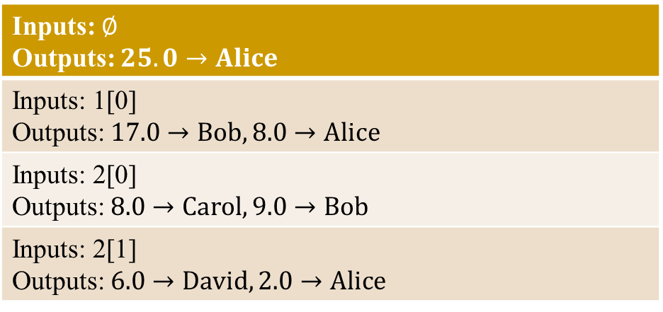
1. Data Structure of Bitcoin
Ledger
transaction-based ledger
1
Inputs: $∅$ Outputs: $25.0→Alice$
Inputs: 1[0] Outputs: $17.0→Bob, 8.0→Alice$
Inputs: 2[0] Outputs: $8.0→Carol, 9.0→Bob$
Inputs: 2[1] Outputs: $6.0→David, 2.0→Alice$
2
Time
Alice Signature
Is this transaction valid？
3
Bob Signature
4
Alice Signature
The inputs for transaction can only be outputs of previous transactions.
Each transaction output can be ‘used’ only one time.
Each transaction consumes unspent transaction output (UTXO) of previous transactions, and generates new outputs.
Use `one-step’ previous transactions to check the validity of a transaction.

Slide 6
1. What is Bitcoin？
Bitcoin
Bitcoin is a transaction-based ledger/database.
Each record is a Transaction.
Each output of each transaction represents a coin, including the information of (owner, value).
Once a coin represented by a transaction output (TXO) is referenced, it means the coin is consumed and the value is transferred to new coins.
Each transaction consumes some existing coins, and generates new coins.
Each coin (TXO) can be consumed only once.
Each transaction can consume only the unspent TXO (UTXO).

Slide 7
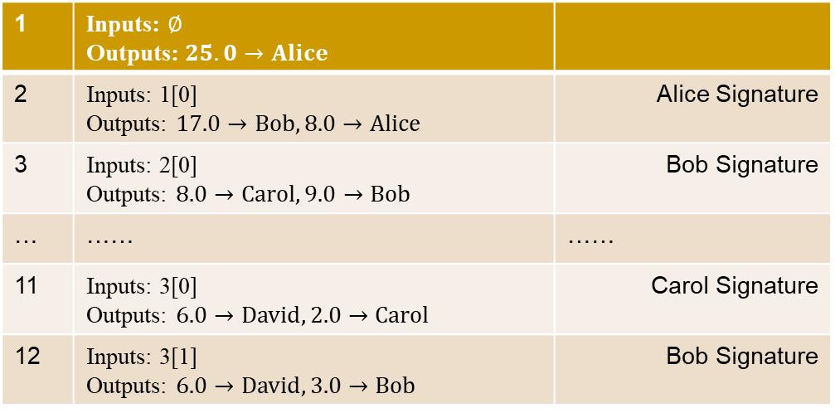
1. What is Bitcoin？
Transaction Chain of Bitcoin
1 | Inputs: $∅$ Outputs: $25.0→Alice$
2 | Inputs: 1[0] Outputs: $17.0→Bob, 8.0→Alice$ | Alice Signature
3 | Inputs: 2[0] Outputs: $8.0→Carol, 9.0→Bob$ | Bob Signature
… | …… | ……
11 | Inputs: 3[0] Outputs: $6.0→David, 2.0→Carol$ | Carol Signature
12 | Inputs: 3[1] Outputs: $6.0→David, 3.0→Bob$ | Bob Signature
Tx1
Tx2
Tx3
……
Tx11
Tx12
David
David

Slide 8
1. What is Bitcoin？
Transaction Chain of Bitcoin
1 | Inputs: $∅$ Outputs: $25.0→Alice$
2 | Inputs: 1[0] Outputs: $17.0→Bob, 8.0→Alice$ | Alice Signature
3 | Inputs: 2[0] Outputs: $8.0→Carol, 9.0→Bob$ | Bob Signature
… | …… | ……
11 | Inputs: 3[0] Outputs: $6.0→David, 2.0→Carol$ | Carol Signature
12 | Inputs: 3[1] Outputs: $6.0→David, 3.0→Bob$ | Bob Signature
How many BTCs does David have？
How does David transfer his BTCs to Ellen？
Tx1
Tx2
Tx3
……
Tx11
Tx12
David
David

Slide 9
1. What is Bitcoin？
Transaction Chain of Bitcoin
1 | Inputs: $∅$ Outputs: $25.0→Alice$
2 | Inputs: 1[0] Outputs: $17.0→Bob, 8.0→Alice$ | Alice Signature
3 | Inputs: 2[0] Outputs: $8.0→Carol, 9.0→Bob$ | Bob Signature
… | …… | ……
11 | Inputs: 3[0] Outputs: $6.0→David, 2.0→Carol$ | Carol Signature
12 | Inputs: 3[1] Outputs: $6.0→David, 3.0→Bob$ | Bob Signature
13 | Inputs: 11[0], 12[0] Outputs: 12$.0→Ellen$ | David Signature David Signature
Tx1
Tx2
Tx3
……
Tx11
Tx12
Tx13
David
David

Slide 10
1. What is Bitcoin？
How to bind a coin to its owner?
How to ensure that only the owner of a coin can spend the coin?
Signature Scheme
Definition：
Key Generation：$\left(vk,sk\right)←Setup(λ)$。
Sign：$σ←Sign(sk,M)$。
Verify： $0/1←Verify(vk,M,σ)$
Security：only the owner of secret key $sk$can generate valid signature.
Use Signature in practice
Bind the identity and the public key
PKI，CA，Certificate

Slide 11
1. What is Bitcoin？
In Bitcoin, public key PK is used as the identity of the owner.
A coin is owned by a PK.
A participant proves he is the owner of a coin, by generating a valid signature that can be verified by the corresponding PK.
No CA.
anonymity
decentralization
Anonymity：
30 82 02 0a 02 82 02 01 00 f3 5d fa 80 67 d4 5a a7 a9 0c 2c 90 20 d0 35 08 3c 75 84 cd b7 07 89 9c 89 da de ce c3 60 fa 91 68 5a 9e 94 71 29 18 76 7c c2 e0 c8 25 76 94 0e 58 fa 04 34 36 e6 df af f7 80 ba e9 58 0b 2b 93 e5 9d 05 e3 77 22 91 f7 34 64 3c 22 91 1d 5e e1 09 90 bc 14 fe fc 75 58 19 e1 79 b7 07 92 a3 ae 88 59 08 d8 9f 07 ca 03 58 fc 68 29 6d 32 d7 d2 a8 cb 4b fc e1 0b 48 32 4f e6 eb b8 ad 4f e4 5c 6f 13 94 99 db 95 d5 75 db a8 1a b7 94 91 b4 77 5b f5 48 0c 8f 6a 79 7d 14 70 04 7d 6d af 90 f5 da 70 d8 47 b7 bf 9b 2f 6c e7 05 b7 e1 11 60 ac 79 91 14 7c c5 d6 a6 e4 e1 7e d5 c3 7e e5 92 d2 3c 00 b5 36 82 de 79 e1 6d f3 b5 6e f8 9f 33 c9 cb 52 7d 73 98 36 db 8b a1 6b a2 95 97 9b a3 de c2 4d 26 ff 06 96 67 25 06 c8 e7 ac e4 ee 12 33 95 31 99 c8 35 08 4e 34 ca 79 53 d5 b5 be 63 32 59 40 36 c0 a5 4e 04 4d 3d db 5b 07 33 e4 58 bf ef 3f 53 64 d8 42 59 35 57 fd 0f 45 7c 24 04 4d 9e d6 38 74 11 97 22 90 ce 68 44 74 92 6f d5 4b 6f b0 86 e3 c7 36 42 a0 d0 fc c1 c0 5a f9 a3 61 b9 30 47 71 96 0a 16 b0 91 c0 42 95 ef 10 7f 28 6a e3 2a 1f b1 e4 cd 03 3f 77 71 04 c7 20 fc 49 0f 1d 45 88 a4 d7 cb 7e 88 ad 8e 2d ec 45 db c4 51 04 c9 2a fc ec 86 9e 9a 11 97 5b de ce 53 88 e6 e2 b7 fd ac 95 c2 28 40 db ef 04 90 df 81 33 39 d9 b2 45 a5 23 87 06 a5 55 89 31 bb 06 2d 60 0e 41 18 7d 1f 2e b5 97 cb 11 eb 15 d5 24 a5 94 ef 15 14 89 fd 4b 73 fa 32 5b fc d1 33 00 f9 59 62 70 07 32 ea 2e ab 40 2d 7b ca dd 21 67 1b 30 99 8f 16 aa 23 a8 41 d1 b0 6e 11 9b 36 c4 de 40 74 9c e1 58 65 c1 60 1e 7a 5b 38 c8 8f bb 04 26 7c d4 16 40 e5 b6 6b 6c aa 86 fd 00 bf ce c1 35 02 03 01 00 01

Slide 12
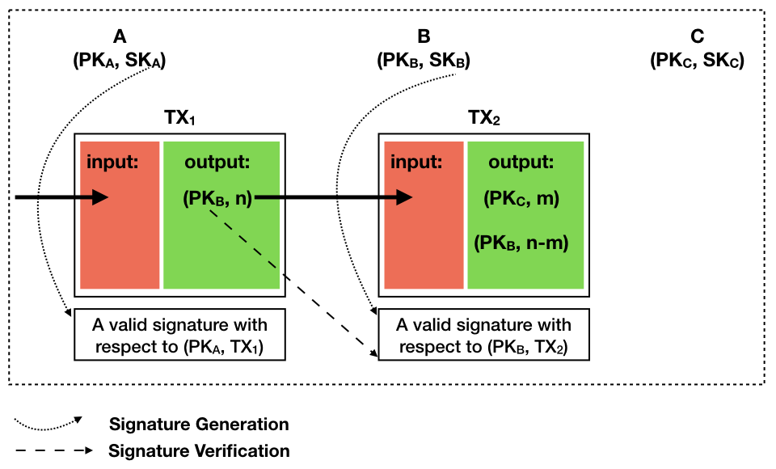
1. What is Bitcoin？
Each TXO uses a public key, say PK, to specify the payee, i.e. the owner of the coin.
When the payee/owner wants to spend this coin (by taking it as input for another transaction), he needs to generate a valid signature (verified by the PK)，to (1) prove that he is indeed the owner of this coin, and (2) to show he approve the transaction details.
The private key corresponding to the public key is the only thing that proves the ownership of the coin.
A->B: n BTC
B->C: m BTC

Slide 13
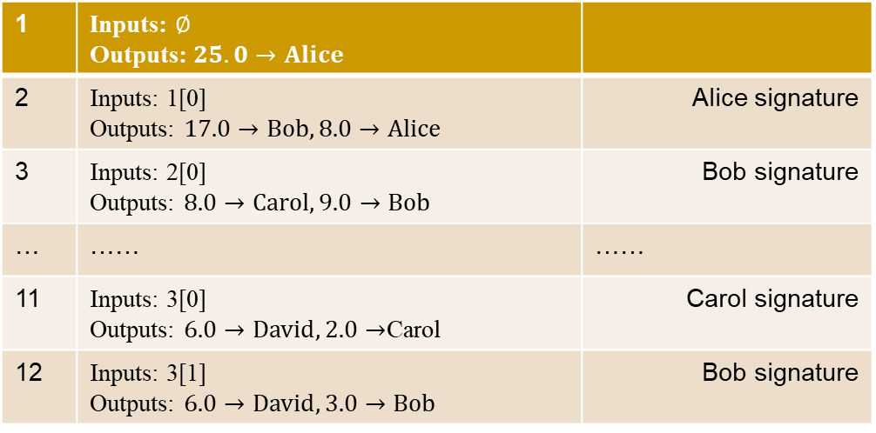
1. What is Bitcoin？:Using Public Key as Identity
Each transaction output is ‘owned’ by a public key, when the owner wants to spend the coin (i.e. transaction output), he need to generate a valid signature corresponding to the public key, to prove that he is the owner of the coin.
The private key corresponding to the public key is the only thing that proves the ownership of the coin.
1 | Inputs: $∅$ Outputs: $25.0→Alice$
2 | Inputs: 1[0] Outputs: $17.0→Bob, 8.0→Alice$ | Alice signature
3 | Inputs: 2[0] Outputs: $8.0→Carol, 9.0→Bob$ | Bob signature
… | …… | ……
11 | Inputs: 3[0] Outputs: $6.0→David, 2.0→$Carol | Carol signature
12 | Inputs: 3[1] Outputs: $6.0→David, 3.0→Bob$ | Bob signature
Alice | (PK1,SK1)
Bob | (PK2,SK2)
Carol | (PK3,SK3)
David | (PK4,SK4)
Ellen | (PK5,SK5)
13 | Inputs: 11[0], 12[0] Outputs: 12$.0→Ellen$ | David signature David signature

Slide 14
1. What is Bitcoin？:Using Public Key as Identity
Each transaction output is ‘owned’ by a public key, when the owner wants to spend the coin (i.e. transaction output), he need to generate a valid signature corresponding to the public key, to prove that he is the owner of the coin.
The private key corresponding to the public key is the only thing that proves the ownership of the coin.
1 | Inputs: $∅$ Outputs: $25.0→PK1$
2 | Inputs: 1[0] Outputs: $17.0→PK2, 8.0→PK1$ | Alice signature
3 | Inputs: 2[0] Outputs: $8.0→PK3, 9.0→PK2$ | Bob signature
… | …… | ……
11 | Inputs: 3[0] Outputs: $6.0→PK4, 2.0→PK3$ | Carol signature
12 | Inputs: 3[1] Outputs: $6.0→PK4, 3.0→PK2$ | Bob signature
Alice | (PK1,SK1)
Bob | (PK2,SK2)
Carol | (PK3,SK3)
David | (PK4,SK4)
Ellen | (PK5,SK5)
13 | Inputs: 11[0], 12[0] Outputs: 12$.0→PK5$ | David signature David signature

Slide 15
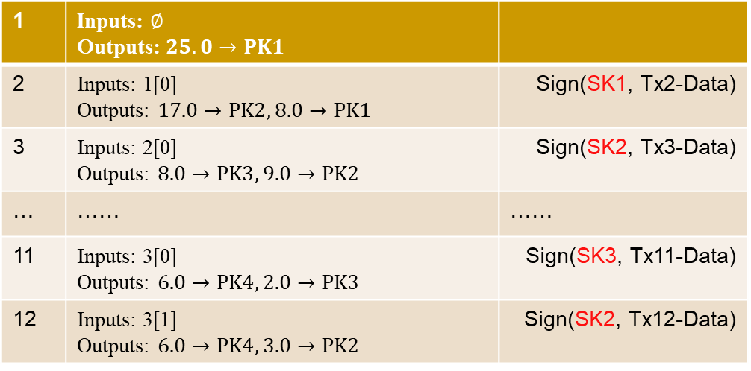
1. What is Bitcoin？:Using Public Key as Identity
Each transaction output is ‘owned’ by a public key, when the owner wants to spend the coin (i.e. transaction output), he need to generate a valid signature corresponding to the public key, to prove that he is the owner of the coin.
The private key corresponding to the public key is the only thing that proves the ownership of the coin.
1 | Inputs: $∅$ Outputs: $25.0→PK1$
2 | Inputs: 1[0] Outputs: $17.0→PK2, 8.0→PK1$ | Sign(SK1, Tx2-Data)
3 | Inputs: 2[0] Outputs: $8.0→PK3, 9.0→PK2$ | Sign(SK2, Tx3-Data)
… | …… | ……
11 | Inputs: 3[0] Outputs: $6.0→PK4, 2.0→PK3$ | Sign(SK3, Tx11-Data)
12 | Inputs: 3[1] Outputs: $6.0→PK4, 3.0→PK2$ | Sign(SK2, Tx12-Data)
Alice | (PK1,SK1)
Bob | (PK2,SK2)
Carol | (PK3,SK3)
David | (PK4,SK4)
Ellen | (PK5,SK5)
13 | Inputs: 11[0], 12[0] Outputs: 1$2.0→PK5$ | Sign(SK4, Tx13-Data) Sign(SK4, Tx13-Data)

Slide 16
1. What is Bitcoin？:Using Public Key as Identity
Each transaction output is ‘owned’ by a public key, when the owner wants to spend the coin (i.e. transaction output), he need to generate a valid signature corresponding to the public key, to prove that he is the owner of the coin.
The private key corresponding to the public key is the only thing that proves the ownership of the coin.
1 | Inputs: $∅$ Outputs: $25.0→PK1$
2 | Inputs: 1[0] Outputs: $17.0→PK2, 8.0→PK1$ | Sign(SK1, Tx2-Data)
3 | Inputs: 2[0] Outputs: $8.0→PK3, 9.0→PK2$ | Sign(SK2, Tx3-Data)
… | …… | ……
11 | Inputs: 3[0] Outputs: $6.0→PK4, 2.0→PK3$ | Sign(SK3, Tx11-Data)
12 | Inputs: 3[1] Outputs: $6.0→PK4, 3.0→PK2$ | Sign(SK2, Tx12-Data)
Receivers are PKs (bit string): anonymity
Observe Tx11 and Tx12
Tx11 and Tx12 are for the same receiver
13 | Inputs: 11[0], 12[0] Outputs: 1$2.0→PK5$ | Sign(SK4, Tx13-Data) Sign(SK4, Tx13-Data)

Slide 17
1. What is Bitcoin？:Using Public Key as Identity
Each participant can generate multiple (public key, private key) pairs.
1 | Inputs: $∅$ Outputs: $25.0→PK1$
2 | Inputs: 1[0] Outputs: $17.0→PK2, 8.0→PK1$ | Sign(SK1, Tx2-Data)
3 | Inputs: 2[0] Outputs: $8.0→PK3, 9.0→PK2$ | Sign(SK2, Tx3-Data)
… | …… | ……
11 | Inputs: 3[0] Outputs: $6.0→PK4, 2.0→PK3$ | Sign(SK3, Tx11-Data)
12 | Inputs: 3[1] Outputs: $6.0→PK4, 3.0→PK2$ | Sign(SK2, Tx12-Data)
Alice | (PK1,SK1)
Bob | (PK2,SK2)
Carol | (PK3,SK3)
David | (PK4,SK4)
Ellen | (PK5,SK5)
David | (PK6,SK6)
13 | Inputs: 11[0], 12[0] Outputs: 1$2.0→PK5$ | Sign(SK4, Tx13-Data) Sign(SK4, Tx13-Data)

Slide 18
1. What is Bitcoin？:Using Public Key as Identity
Each participant can generate multiple (public key, private key) pairs.
1 | Inputs: $∅$ Outputs: $25.0→PK1$
2 | Inputs: 1[0] Outputs: $17.0→PK2, 8.0→PK1$ | Sign(SK1, Tx2-Data)
3 | Inputs: 2[0] Outputs: $8.0→PK3, 9.0→PK2$ | Sign(SK2, Tx3-Data)
… | …… | ……
11 | Inputs: 3[0] Outputs: $6.0→PK4, 2.0→PK3$ | Sign(SK3, Tx11-Data)
12 | Inputs: 3[1] Outputs: $6.0→PK6, 3.0→PK2$ | Sign(SK2, Tx12-Data)
Alice | (PK1,SK1)
Bob | (PK2,SK2)
Carol | (PK3,SK3)
David | (PK4,SK4)
Ellen | (PK5,SK5)
David | (PK6,SK6)
13 | Inputs: 11[0], 12[0] Outputs: 1$2.0→PK5$ | Sign(SK4, Tx13-Data) Sign(SK6, Tx13-Data)

Slide 19
1. What is Bitcoin？:Using Public Key as Identity
Each participant can generate multiple (public key, private key) pairs.
Each coin use a different public key: one-time coin address.
Observe Tx3 and Tx12
The senders for Tx3 and Tx12 are the same.
1 | Inputs: $∅$ Outputs: $25.0→PK1$
2 | Inputs: 1[0] Outputs: $17.0→PK2, 8.0→PK1$ | Sign(SK1, Tx2-Data)
3 | Inputs: 2[0] Outputs: $8.0→PK3, 9.0→PK2$ | Sign(SK2, Tx3-Data)
… | …… | ……
11 | Inputs: 3[0] Outputs: $6.0→PK4, 2.0→PK3$ | Sign(SK3, Tx11-Data)
12 | Inputs: 3[1] Outputs: $6.0→PK6, 3.0→PK2$ | Sign(SK2, Tx12-Data)
Alice | (PK1,SK1)
Bob | (PK2,SK2)
Carol | (PK3,SK3)
David | (PK4,SK4)
Ellen | (PK5,SK5)
David | (PK6,SK6)
Bob | (PK7,SK7)
13 | Inputs: 11[0], 12[0] Outputs: 1$2.0→PK5$ | Sign(SK4, Tx13-Data) Sign(SK6, Tx13-Data)

Slide 20
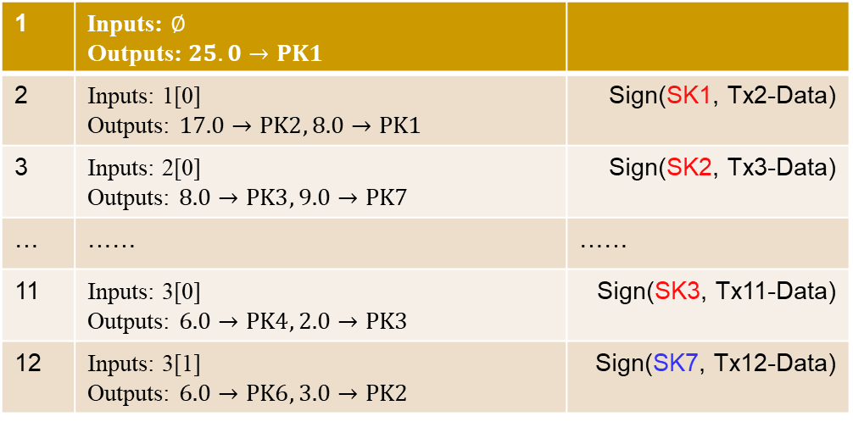
1. What is Bitcoin？:Using Public Key as Identity
Each participant can generate multiple (public key, private key) pairs.
Each coin use a different public key: one-time coin address.
1 | Inputs: $∅$ Outputs: $25.0→PK1$
2 | Inputs: 1[0] Outputs: $17.0→PK2, 8.0→PK1$ | Sign(SK1, Tx2-Data)
3 | Inputs: 2[0] Outputs: $8.0→PK3, 9.0→PK7$ | Sign(SK2, Tx3-Data)
… | …… | ……
11 | Inputs: 3[0] Outputs: $6.0→PK4, 2.0→PK3$ | Sign(SK3, Tx11-Data)
12 | Inputs: 3[1] Outputs: $6.0→PK6, 3.0→PK2$ | Sign(SK7, Tx12-Data)
Alice | (PK1,SK1)
Bob | (PK2,SK2)
Carol | (PK3,SK3)
David | (PK4,SK4)
Ellen | (PK5,SK5)
David | (PK6,SK6)
Bob | (PK7,SK7)
13 | Inputs: 11[0], 12[0] Outputs: 1$2.0→PK5$ | Sign(SK4, Tx13-Data) Sign(SK6, Tx13-Data)

Slide 21
1. What is Bitcoin？:Using Public Key as Identity
Each participant can generate multiple (public key, private key) pairs.
Each coin use a different public key: one-time coin address.
1 | Inputs: $∅$ Outputs: $25.0→PK1$
2 | Inputs: 1[0] Outputs: $17.0→PK2, 8.0→PK1$ | Sign(SK1, Tx2-Data)
3 | Inputs: 2[0] Outputs: $8.0→PK3, 9.0→PK7$ | Sign(SK2, Tx3-Data)
… | …… | ……
11 | Inputs: 3[0] Outputs: $6.0→PK4, 2.0→PK3$ | Sign(SK3, Tx11-Data)
12 | Inputs: 3[1] Outputs: $6.0→PK6, 3.0→PK2$ | Sign(SK7, Tx12-Data)
Alice | (PK1,SK1)
Bob | (PK2,SK2)
Carol | (PK3,SK3)
David | (PK4,SK4)
Ellen | (PK5,SK5)
David | (PK6,SK6)
Bob | (PK7,SK7)
13 | Inputs: 11[0], 12[0] Outputs: 1$2.0→PK5$ | Sign(SK4, Tx13-Data) Sign(SK6, Tx13-Data)
Alice | (PK8,SK8)

Slide 22
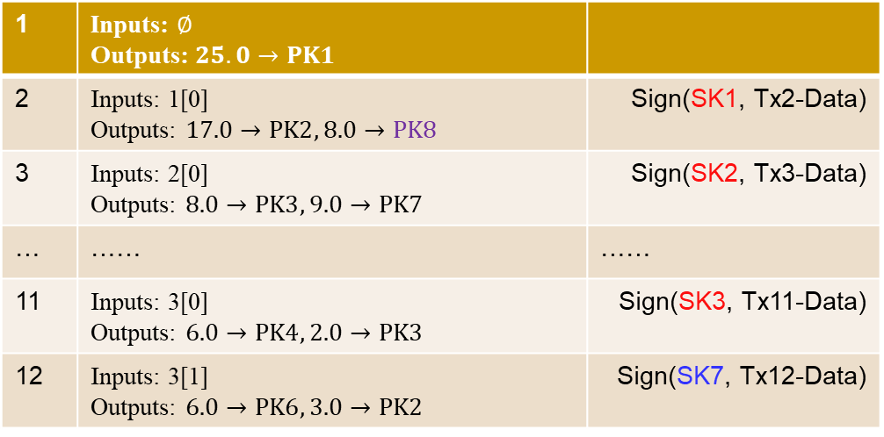
1. What is Bitcoin？:Using Public Key as Identity
Each participant can generate multiple (public key, private key) pairs.
Each coin use a different public key: one-time coin address.
1 | Inputs: $∅$ Outputs: $25.0→PK1$
2 | Inputs: 1[0] Outputs: $17.0→PK2, 8.0→PK8$ | Sign(SK1, Tx2-Data)
3 | Inputs: 2[0] Outputs: $8.0→PK3, 9.0→PK7$ | Sign(SK2, Tx3-Data)
… | …… | ……
11 | Inputs: 3[0] Outputs: $6.0→PK4, 2.0→PK3$ | Sign(SK3, Tx11-Data)
12 | Inputs: 3[1] Outputs: $6.0→PK6, 3.0→PK2$ | Sign(SK7, Tx12-Data)
Alice | (PK1,SK1)
Bob | (PK2,SK2)
Carol | (PK3,SK3)
David | (PK4,SK4)
Ellen | (PK5,SK5)
David | (PK6,SK6)
Bob | (PK7,SK7)
13 | Inputs: 11[0], 12[0] Outputs: 1$2.0→PK5$ | Sign(SK4, Tx13-Data) Sign(SK6, Tx13-Data)
Alice | (PK8,SK8)
Carol | (PK9,SK9)

Slide 23
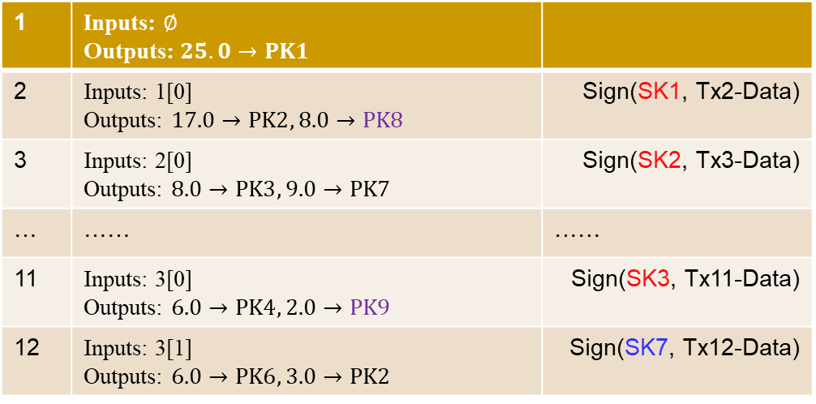
1. What is Bitcoin？:Using Public Key as Identity
Each participant can generate multiple (public key, private key) pairs.
Each coin use a different public key: one-time coin address.
1 | Inputs: $∅$ Outputs: $25.0→PK1$
2 | Inputs: 1[0] Outputs: $17.0→PK2, 8.0→PK8$ | Sign(SK1, Tx2-Data)
3 | Inputs: 2[0] Outputs: $8.0→PK3, 9.0→PK7$ | Sign(SK2, Tx3-Data)
… | …… | ……
11 | Inputs: 3[0] Outputs: $6.0→PK4, 2.0→PK9$ | Sign(SK3, Tx11-Data)
12 | Inputs: 3[1] Outputs: $6.0→PK6, 3.0→PK2$ | Sign(SK7, Tx12-Data)
Alice | (PK1,SK1)
Bob | (PK2,SK2)
Carol | (PK3,SK3)
David | (PK4,SK4)
Ellen | (PK5,SK5)
David | (PK6,SK6)
Bob | (PK7,SK7)
13 | Inputs: 11[0], 12[0] Outputs: 1$2.0→PK5$ | Sign(SK4, Tx13-Data) Sign(SK6, Tx13-Data)
Alice | (PK8,SK8)
Carol | (PK9,SK9)
Bob | (PK10,SK10)

Slide 24
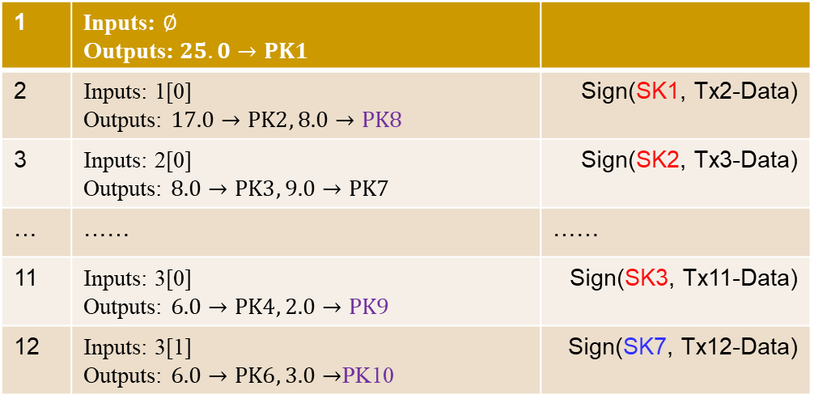
1. What is Bitcoin？:Using Public Key as Identity
Each participant can generate multiple (public key, private key) pairs.
Each coin use a different public key: one-time coin address.
1 | Inputs: $∅$ Outputs: $25.0→PK1$
2 | Inputs: 1[0] Outputs: $17.0→PK2, 8.0→PK8$ | Sign(SK1, Tx2-Data)
3 | Inputs: 2[0] Outputs: $8.0→PK3, 9.0→PK7$ | Sign(SK2, Tx3-Data)
… | …… | ……
11 | Inputs: 3[0] Outputs: $6.0→PK4, 2.0→PK9$ | Sign(SK3, Tx11-Data)
12 | Inputs: 3[1] Outputs: $6.0→PK6, 3.0→$PK10 | Sign(SK7, Tx12-Data)
Alice | (PK1,SK1)
Bob | (PK2,SK2)
Carol | (PK3,SK3)
David | (PK4,SK4)
Ellen | (PK5,SK5)
David | (PK6,SK6)
Bob | (PK7,SK7)
13 | Inputs: 11[0], 12[0] Outputs: 1$2.0→PK5$ | Sign(SK4, Tx13-Data) Sign(SK6, Tx13-Data)
Alice | (PK8,SK8)
Carol | (PK9,SK9)
Bob | (PK10,SK10)

Slide 25
1. What is Bitcoin？:Using Public Key as Identity
Each participant can generate multiple (public key, private key) pairs.
Each coin use a different public key: one-time coin address.
Do not use always put change to the fix position of outputs.
How to improve Bitcoin’s privacy?
PK1 and PK8 may belong to the same person.
1 | Inputs: $∅$ Outputs: $25.0→PK1$
2 | Inputs: 1[0] Outputs: $17.0→PK2, 8.0→PK8$ | Sign(SK1, Tx2-Data)
3 | Inputs: 2[0] Outputs: $8.0→PK3, 9.0→PK7$ | Sign(SK2, Tx3-Data)
… | …… | ……
11 | Inputs: 3[0] Outputs: $6.0→PK4, 2.0→PK9$ | Sign(SK3, Tx11-Data)
12 | Inputs: 3[1] Outputs: $6.0→PK6, 3.0→$PK10 | Sign(SK7, Tx12-Data)
PK2 and PK7 may belong to the same person.
PK4 and PK6 may belong to the same person.
13 | Inputs: 11[0], 12[0] Outputs: 1$2.0→PK5$ | Sign(SK4, Tx13-Data) Sign(SK6, Tx13-Data)

Slide 26
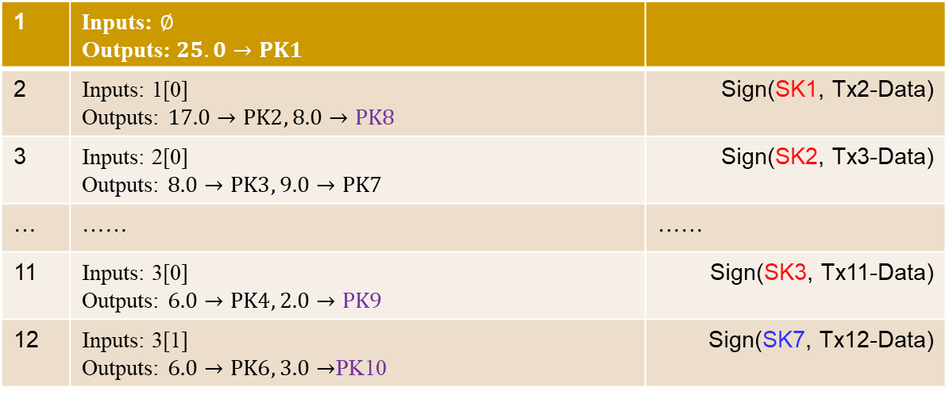
1. What is Bitcoin？:Coin Address of Bitcoin
TXO use Hash(PK) as the coin address, where PK is the public key of the receiver
To receiver a coin, the receiver does not need to give public key to the sender, instead, just gives a hash value, say addr to the sender
When the receiver (i.e. owner) of a coin wants to spend the coin, he needs to provide a (public key, signature) pair (pk, $σ$), such that $H\left(pk\right)=addr∧Verify\left(pk, tx, σ\right)=1,$where $tx$ is the transaction to spend the coin.
1 | Inputs: $∅$ Outputs: $25.0→PK1$
2 | Inputs: 1[0] Outputs: $17.0→PK2, 8.0→PK8$ | Sign(SK1, Tx2-Data)
3 | Inputs: 2[0] Outputs: $8.0→PK3, 9.0→PK7$ | Sign(SK2, Tx3-Data)
… | …… | ……
11 | Inputs: 3[0] Outputs: $6.0→PK4, 2.0→PK9$ | Sign(SK3, Tx11-Data)
12 | Inputs: 3[1] Outputs: $6.0→PK6, 3.0→$PK10 | Sign(SK7, Tx12-Data)
13 | Inputs: 11[0], 12[0] Outputs: 12$.0→PK5$ | Sign(SK4, Tx13-Data) Sign(SK6, Tx13-Data)

Slide 27
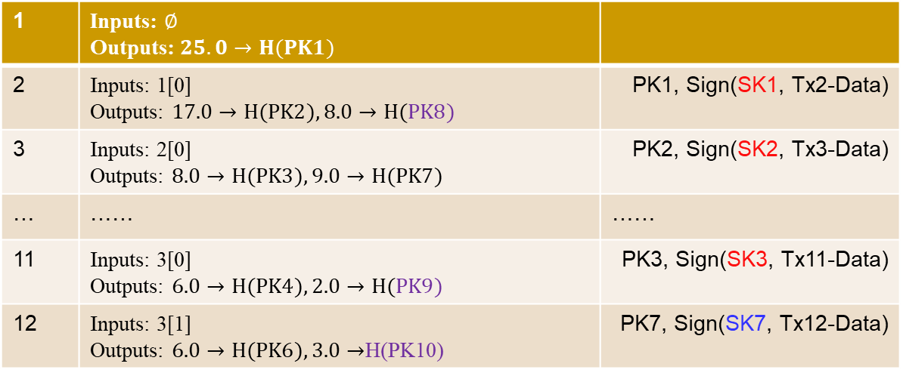
1. What is Bitcoin？:Coin Address of Bitcoin
TXO use Hash(PK) as the coin address, where PK is the public key of the receiver
To receiver a coin, the receiver does not need to give public key to the sender, instead, just gives a hash value, say addr to the sender
When the receiver (i.e. owner) of a coin wants to spend the coin, he needs to provide a (public key, signature) pair (pk, $σ$), such that $H\left(pk\right)=addr∧Verify\left(pk, tx, σ\right)=1,$where $tx$ is the transaction to spend the coin.
1 | Inputs: $∅$ Outputs: $25.0→H(PK1)$
2 | Inputs: 1[0] Outputs: $17.0→H(PK2), 8.0→H(PK8)$ | PK1, Sign(SK1, Tx2-Data)
3 | Inputs: 2[0] Outputs: $8.0→H(PK3), 9.0→H(PK7)$ | PK2, Sign(SK2, Tx3-Data)
… | …… | ……
11 | Inputs: 3[0] Outputs: $6.0→H(PK4), 2.0→H(PK9)$ | PK3, Sign(SK3, Tx11-Data)
12 | Inputs: 3[1] Outputs: $6.0→H(PK6), 3.0→$H(PK10) | PK7, Sign(SK7, Tx12-Data)
13 | Inputs: 11[0], 12[0] Outputs: 12$.0→H(PK5)$ | PK4, Sign(SK4, Tx13-Data) PK6, Sign(SK6, Tx13-Data)

Slide 28
1. What is Bitcoin？:Coin Address of Bitcoin
What are the advantages of using $H\left(pk\right)$ rather than $pk$ as the coin address?
Only when a coin is spent, the value of pk appears
Support extension functionalities
The coin address is just a hash value, may be that of a pk, or a script string.
1 | Inputs: $∅$ Outputs: $25.0→H(PK1)$
2 | Inputs: 1[0] Outputs: $17.0→H(PK2), 8.0→H(PK8)$ | PK1, Sign(SK1, Tx2-Data)
3 | Inputs: 2[0] Outputs: $8.0→H(PK3), 9.0→H(PK7)$ | PK2, Sign(SK2, Tx3-Data)
… | …… | ……
11 | Inputs: 3[0] Outputs: $6.0→H(PK4), 2.0→H(PK9)$ | PK3, Sign(SK3, Tx11-Data)
12 | Inputs: 3[1] Outputs: $6.0→H(PK6), 3.0→$H(PK10) | PK7, Sign(SK7, Tx12-Data)
13 | Inputs: 11[0], 12[0] Outputs: 12$.0→H(PK5)$ | PK4, Sign(SK4, Tx13-Data) PK6, Sign(SK6, Tx13-Data)

Slide 29
1. What is Bitcoin？:Coin Address of Bitcoin
Coin address is a hash value
It could be hash value of any string, for example, source codes
If
Rule=‘if it rains on April 21, the coin is sent to addr_B, else to H(PK10)’，
Hval = H(Rule), and
The evidence of ‘it rains on April 21’ is verified valid, and
H(PK_B)=Addr_B, and
Verify (pk_b, tx_4, sign(SK_B, Tx_4))= 1
Then Tx_4 is valid
1 | Inputs: $∅$ Outputs: $25.0→H(PK1)$
2 | Inputs: $∅$ Outputs: $25.0→H(PK2)$
3 | Inputs: 1[0] Outputs: $18.0→Hval,7.0→H(PK1)$ | PK1, Sign(SK1, Tx2-Data)
4 | Inputs: 3[0] Outputs: 10$.0→H(PK5)$, 8$.0→H(PK6)$, | Rule, evidence of ‘it rains on April 21’， PK_B, Sign(SK_B, Tx4)

