Slide 1
Networking Overview: “Everything” you need to know, in 50 minutes
Network Security
Prof. Haojin Zhu
Adopted from David Wagner @ UC Berkeley
May 8, 2019

Slide 2
Local-Area Networks
A
C
point-to-point
shared
How does computer A send a message to computer C?

Slide 3
Local-Area Networks: Packets
From: A To: C
Message: Hello world!
A | C | Hello world!
A | C
Hello world!

Slide 4
Wide-Area Networks
A
router C
How do we connect two LANs?

Slide 5
Wide-Area Networks
A
A
R
A.com
C.com
Hello
world!
How do we connect two LANs?
router C
R
C
A.com | C.com
Hello world!
A.com
C.com
Hello world!
5

Slide 6
Key Concept #1: Protocols
A protocol is an agreement on how to communicate
Includes syntax and semantics
How a communication is specified & structured
o Format, order messages are sent and received
What a communication means
o Actions taken when transmitting, receiving, or timer expires
Example: making a comment in lecture?
Raise your hand.
Wait to be called on.
Or: wait for speaker to pause and vocalize
4. If unrecognized (after timeout): say “excuse me”
6

Slide 7
Key Concept #2: Dumb Network
Original Internet design: interior nodes (“routers”) have no knowledge* of ongoing connections going through them
Not how you picture the telephone system works
Which internally tracks all of the active voice calls
Instead: the postal system!
Each Internet message (“packet”) self-contained
* Today’s Internet is full of hacks that violate this
7

Slide 8
Self-Contained IP Packet Format
IP = Internet Protocol
4-bit Version
4-bit Header Length
8-bit
Type of Service
(TOS)
16-bit Total Length (Bytes)
16-bit Identification
3-bit Flags
13-bit Fragment Offset
Header is like a letter envelope: contains all info needed for delivery
8-bit Time to Live (TTL)
8-bit Protocol
16-bit Header Checksum
32-bit Source IP Address
32-bit Destination IP Address
Payload (remainder of message)
.
.
.
.
.

Slide 9
Key Concept #2: Dumb Network
Original Internet design: interior nodes (“routers”) have no knowledge* of ongoing connections going through them
Not: how you picture the telephone system works
Which internally tracks all of the active voice calls
Instead: the postal system!
Each Internet message (“packet”) self-contained
Interior routers look at destination address to forward
If you want smarts, build it “end-to-end”, not “hop-by-hop”
Buys simplicity & robustness at the cost of shifting complexity into end systems
* Today’s Internet is full of hacks that violate this
9

Slide 10
Key Concept #3: Layering
Internet design is strongly partitioned into layers
Each layer relies on services provided by next layer below …
… and provides services to layer above it
Analogy:
Code You Write
Run-Time Library
– Consider structure of an application you’ve written and the “services” each layer relies on / provides
System Calls
}
Device Drivers
Fully
isolated
Voltage Levels / Magnetic Domains
from user
programs

Slide 11
Internet Layering (“Protocol Stack”)
Note on a point of potential confusion: these diagrams are always drawn with lower layers below higher layers …
But diagrams showing the layouts of packets are often the opposite, with the lower layers at the top since their headers precede those for higher layers
7
4
3
2
1
Application
Transport
(Inter)Network
Link
Physical

Slide 12
Horizontal View of a Single Packet
First bit transmitted
Link Layer Header
(Inter)Network Layer Header (IP)
Transport Layer Header
Application Data: structure depends on the application
…

Slide 13
Vertical View of a Single Packet
Link Layer Header
First bit transmitted
(Inter)Network Layer Header (IP)
Transport Layer Header
Application Data: structure depends on the application
.
.
.
.
.
.
.
13

Slide 14
Internet Layering (“Protocol Stack”)
7
4
3
2
1
Application
Transport
(Inter)Network
Link
Physical

Slide 15
Layer 1: Physical Layer
7
4
3
2
Application
Transport
(Inter)Network
Encoding bits to send them over a single physical link
e.g. patterns of voltage levels / photon intensities / RF modulation
Link
Physical
1

Slide 16
Layer 2: Link Layer
Framing and transmission of a collection of bits into individual messages sent across a single “subnetwork” (one physical technology)
Might involve multiple physical links (e.g., modern Ethernet)
Often technology supports broadcast transmission (every “node” connected to subnet receives)
7
4
3
2
1
Application
Transport
(Inter)Network
Link
Physical

Slide 17
Layer 3: (Inter)Network Layer (IP)
Bridges multiple “subnets” to provide end-to-end internet connectivity between nodes
Provides global addressing
7
4
3
2
Application
Transport
(Inter)Network
Works across different link technologies
}
Link
Physical
Different for each
1
Internet “hop”

Slide 18
Layer 4: Transport Layer
End-to-end communication between processes
Different services provided: TCP = reliable byte stream UDP = unreliable datagrams
(Datagram = single packet message)
7
4
3
2
1
Application
Transport
(Inter)Network
Link
Physical

Slide 19
Layer 7: Application Layer
Communication of whatever you wish
Can use whatever transport(s) is convenient
Freely structured E.g.:
Skype, SMTP (email),
HTTP (Web), Halo, BitTorrent
7
4
3
2
1
Application
Transport
(Inter)Network
Link
Physical

Slide 20
Internet Layering (“Protocol Stack”)
}
7
4
3
2
Application
Transport
(Inter)Network
Implemented only at hosts,
not at interior router
(“dumb network”)
Link
Physical
1

Slide 21
Internet Layering (“Protocol Stack”)
7
4
3
2
Application
Transport
(Inter)Network
}
Link
Physical
Implemented everywhere
1

Slide 22
Internet Layering (“Protocol Stack”)
7
4
3
2
Application
Transport
(Inter)Network
} ~Same for each Internet “hop”
}”
Link
Physical
Different for each
Internet “hop
1

Slide 23
Hop-By-Hop vs. End-to-End Layers
Host A communicates with Host D
Host C
Host A
Router 1
Host D
Router 2
Router 3
Router 5
Host B
Router 4
Router 7
Host E
Router 6

Slide 24
Hop-By-Hop vs. End-to-End Layers
Host A communicates with Host D
Host C
Host A
Router 1
E.g., Wi-Fi
Host D
E.g., Ethernet
Router 3
Router 2
Router 5
Host B
Router 4
Router 7
Host E
Router 6
Different Physical & Link Layers (Layers 1 & 2)

Slide 25
Hop-By-Hop vs. End-to-End Layers
Host A communicates with Host D
Host C
Host A
Router 1
Host D
Router 2
Router 3
Router 5
E.g., HTTP over TCP over IP
Host B
Router 4
Router 7
Host E
Router 6
Same Network / Transport / Application Layers (3/4/7) (Routers ignore Transport & Application layers)

Slide 26
Layer 3: (Inter)Network Layer (IP)
Bridges multiple “subnets” to provide end-to-end internet connectivity between nodes
Provides global addressing
Works across different link technologies
7
4
3
2
1
Application
Transport
(Inter)Network
Link
Physical
26

Slide 27
IP Packet Structure
_{4-bit} 4-bit 8-bit _{Version} Header Type of Service 16-bit Total Length (Bytes) Length (TOS) 3-bit 16-bit Identification _{Flags} 13-bit Fragment Offset 8-bit Time to _{Live (TTL)} 8-bit Protocol 16-bit Header Checksum 32-bit Source IP Address 32-bit Destination IP Address
Options (if any)
Payload

Slide 28
IP Packet Structure
4-bit Version
4-bit Header Length
8-bit
Type of Service
(TOS)
16-bit Total Length (Bytes)
16-bit Identification
3-bit
13-bit Fragment Offset
Fla
gs
16-bit Header Checksum
Specifies the length of the entire IP packet: bytes in this header plus bytes in the Payload
8-bit Time to Live (TTL)
8-bit Protocol
32-bit Source IP Address
32-bit Destination IP Address
Options (if any)
Payload

Slide 29
IP Packet Structure
4-bit Version
4-bit Header Length
8-bit
Type of Service
(TOS)
16-bit Total Length (Bytes)
16-bit Identification
3-bit
_{gs} 13-bit Fragment Offset
16-bit Header Checksum
Fla
Specifies how to interpret the start of the Payload, which is the header of a Transport Protocol such as TCP or UDP
8-bit Time to Live (TTL)
8-bit Protocol
32-bit Source IP Address
32-bit Destination IP Address
Options (if any)
Payload

Slide 30
IP Packet Structure
4-bit Version
4-bit Header Length
8-bit
Type of Service
(TOS)
16-bit Total Length (Bytes)
16-bit Identification
3-bit Flags
13-bit Fragment Offset
8-bit Time to Live (TTL)
8-bit Protocol
16-bit Header Checksum
32-bit Source IP Address
32-bit Destination IP Address
Options (if any)
Payload

Slide 31
IP Packet Header (Continued)
Two IP addresses
–Source IP address (32 bits)
–Destination IP address (32 bits)
Destination address
–Unique identifier/locator for the receiving host
–Allows each node to make forwarding decisions
Source address
–Unique identifier/locator for the sending host
–Recipient can decide whether to accept packet
–Enables recipient to send a reply back to source
31

Slide 32
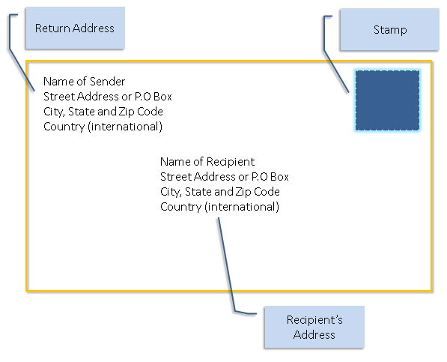
Postal Envelopes:
(Post office doesn’t look at the letter
inside the envelope)
32

Slide 33
Analogy of IP to Postal Envelopes:
IP source address
IP destination address
(Routers don’t look at the payload beyond
the IP header)

Slide 34
IP:“Best Effort ” Packet Delivery
Routers inspect destination address, locate “next hop” in forwarding table
Address = ~unique identifier/locator for the receiving host
Only provides a “I’ll give it a try” delivery service:
Packets may be lost
Packets may be corrupted
Packets may be delivered out of order
source
destination
IP network

Slide 35
“Best Effort ” is Lame! What to do?
It’s the job of our Transport (layer 4) protocols to build services our apps need out of IP’s modest layer-3 service

Slide 36
Layer 4: Transport Layer
End-to-end communication between processes
Different services provided: TCP = reliable byte stream UDP = unreliable datagrams
(Datagram = single packet message)
7
4
3
2
1
Application
Transport
(Inter)Network
Link
Physical

Slide 37
“Best Effort” is Lame! What to do?
It’s the job of our Transport (layer 4) protocols to build services our apps need out of IP’s modest layer-3 service
#1 workhorse: TCP (Transmission Control Protocol)
Service provided by TCP:
Connection oriented (explicit set-up / tear-down)
o End hosts (processes) can have multiple concurrent long-lived communication
Reliable, in-order, byte-stream delivery
o Robust detection & retransmission of lost data

Slide 38
TCP “Bytestream” Service
Process A on host H1
Byte 3
Byte 2
Byte 1
Byte 0
Byte 80
Hosts don’t ever see packet boundaries, lost or corrupted packets, retransmissions, etc.
Process B on host H2
Byte 0 | Byte 1 | Byte 2 | Byte 3
Byte 80

Slide 39
Bidirectional communication:
Process B on host H2
Byte 3
Byte 2
Byte 1
Byte 0
Byte 73
There are two separate bytestreams, one in each direction
Process A on host H1
Byte 0 | Byte 1 | Byte 2 | Byte 3
Byte 73

Slide 40
TCP Header
Source port |  |  | Destination port
Sequence number
Acknowledgment
HdrLen | 0 | Flags |  | Advertised window
Checksum |  |  |  | Urgent pointer
Options (variable)
Data

Slide 41
TCP Header
Ports are associated with OS processes
Source port |  |  | Destination port
Sequence number
Acknowledgment
HdrLen | 0 | Flags |  | Advertised window
Checksum |  |  |  | Urgent pointer
Options (variable)
Data

Slide 42
(Link Layer Header)
TCP Header
(IP Header)
Ports are associated with OS processes
Source port
Destination port
Sequence number
Acknowledgment
IP source & destination addresses plus TCP source and destination ports uniquely identifies a TCP connection
HdrLen
0
Flags
Advertised window
Checksum
Urgent pointer
Options (variable)
Data

Slide 43
TCP Header
Ports are associated with OS processes
IP source & destination addresses plus TCP source and destination ports uniquely identifies a TCP connection
Some port numbers are
“well known” / reserved
e.g. port 80 = HTTP
Source port |  |  | Destination port
Sequence number
Acknowledgment
HdrLen | 0 | Flags |  | Advertised window
Checksum |  |  |  | Urgent pointer
Options (variable)
Data

Slide 44
TCP Header
Starting sequence number (byte offset) of data carried in this packet
Source port |  |  | Destination port
Sequence number
Acknowledgment
HdrLen | 0 | Flags |  | Advertised window
Checksum |  |  |  | Urgent pointer
Options (variable)
Data

Slide 45
TCP Header
Starting sequence number (byte offset) of data carried in this packet
Byte streams numbered independently in each direction
Source port |  |  | Destination port
Sequence number
Acknowledgment
HdrLen | 0 | Flags |  | Advertised window
Checksum |  |  |  | Urgent pointer
Options (variable)
Data

Slide 46
TCP Header
Starting sequence number (byte offset) of data carried in this packet
Source port
Destination port
Sequence number
Acknowledgment
HdrLen
0
Flags
Advertised window
Checksum
Urgent pointer
Byte stream numbered independently in each direction
Options (variable)
Data
Sequence number assigned to start of byte stream is picked when
connection begins; doesn’t start at 0
46

Slide 47
TCP Header
Source port |  |  | Destination port
Sequence number
Acknowledgment
HdrLen | 0 | Flags |  | Advertised window
Checksum |  |  |  | Urgent pointer
Options (variable)
Data
Acknowledgment gives seq # just beyond highest seq. received in order.
If sender sends N bytestream bytes starting at seq S then “ack” for it will be S+N.

Slide 48
Sequence Numbers
Host A
ISN (initial sequence number)
Sequence
TCP HDR
TCP Data
ACK sequence
number from A
number from B
= 1st byte of data
= next expected byte
TCP HDR
TCP Data
Host B

Slide 49
TCP Header
Source port
Destination port
Uses include:
Sequence number
Acknowledgment
acknowledging data (“ACK”)
HdrLen
0
Flags
Advertised window
setting up (“SYN”) and closing connections (“FIN” and
“RST”)
Checksum
Urgent pointer
Options (variable)
Data

Slide 50
Establishing a TCP Connection
A
B
SYN
Each host tells its Initial Sequence Number (ISN) to the other host.
(Spec says to pick based on local clock)
SYN+A
ACK
Data
Data
Three-way handshake to establish connection
Host A sends a SYN (open; “synchronize sequence numbers”) to host B
Host B returns a SYN acknowledgment (SYN+ACK)
Host A sends an ACK to acknowledge the SYN+ACK
50

Slide 51
Timing Diagram: 3-Way Handshaking
Passive Open
Different starting initial sequence numbers (ISNs) in each direction
Active Open
Server
listen()
Client (initiator)
connect()
SYN, SeqNum = x
k = x + 1
SYN + ACK, SeqNum = y, A
ACK, Ack = y + 1
accept()

Slide 52
Extra Material

Slide 53
Layer 7: Application Layer
Communication of whatever you wish
Can use whatever transport(s) is convenient
Freely structured E.g.:
Skype, SMTP (email),
HTTP (Web), Halo, BitTorrent
7
4
3
2
1
Application
Transport
(Inter)Network
Link
Physical

Slide 54
Web (HTTP) Request
Method
Resource
HTTP version
Headers
GET /index.html HTTP/1.1
Accept: image/gif, image/x-bitmap, image/jpeg, */*
Accept-Language: en Connection: Keep-Alive
User-Agent: Mozilla/1.22 (compatible; MSIE Host: www.example.com
Referer: http://www.google.com?q=dingbats
2.0;
Windows 95)
Blank line Data (if POST; none for GET)
download data. POST:
GET:
upload data.

Slide 55
Web (HTTP) Response
HTTP version
Status code
Reason phrase
Headers
HTTP/1.0 200 OK
Date: Sun, 19 Apr 2009 02:20:42 GMT
Server: Microsoft-Internet-Information-Server/5.0 Connection: keep-alive
Content-Type: text/html
Last-Modified: Sat, 18 Apr 2009 17:39:05 GMT
Set-Cookie: session=44eb; path=/servlets Content-Length: 2543
Data
<HTML> Some data... blah, blah, blah </HTML>

Slide 56
Host Names vs. IP addresses
Host names
–Examples: www.cnn.com and bbc.co.uk
–Mnemonic name appreciated by humans
–Variable length, full alphabet of characters
–Provide little (if any) information about location
IP addresses
–Examples: 64.236.16.20 and 212.58.224.131
–Numerical address appreciated by routers
–Fixed length, binary number
–Hierarchical, related to host location
56

Slide 57
IP Packet Structure
4-bit Version
4-bit Header Length
8-bit
Type of Service
(TOS)
16-bit Total Length (Bytes)
16-bit Identification
3-bit Flags
13-bit Fragment Offset
8-bit Time to Live (TTL)
8-bit Protocol
16-bit Header Checksum
32-bit Source IP Address
32-bit Destination IP Address
Options (if any) Payload

Slide 58
IP Packet Header Fields (Continued)
Total length (16 bits)
Number of bytes in the packet
Maximum size is 65,535 bytes (2¹⁶ -1)
… though underlying links may impose smaller limits
Fragmentation: when forwarding a packet, an Internet router can split it into multiple pieces (“fragments”) if too big for next hop link
End host reassembles to recover original packet
Fragmentation information (32 bits)
Packet identifier, flags, and fragment offset
Supports dividing a large IP packet into fragments
… in case a link cannot handle a large IP packet

Slide 59
Example: E-Mail Message Using MIME
MIME version
From: jrex@cs.princeton.edu To: feamster@cc.gatech.edu Subject: picture of my cat MIME-Version: 1.0
Content-Transfer-Encoding: base64
Content-Type: image/jpeg
method used to encode data
type and subtype
Base64 encoded data ….
JVBERi0xLjMNJeLjz9MNMSAwI
.........................
......base64 encoded data
encoded data

Slide 60
Example With Received Header
Return-Path: <casado@cs.stanford.edu>
Received: from ribavirin.CS.Princeton.EDU (ribavirin.CS.Princeton.EDU [128.112.136.44])
by newark.CS.Princeton.EDU (8.12.11/8.12.11) with SMTP id k04M5R7Y023164 for <jrex@newark.CS.Princeton.EDU>; Wed, 4 Jan 2006 17:05:37 -0500 (EST)
Received: from bluebox.CS.Princeton.EDU ([128.112.136.38])
by ribavirin.CS.Princeton.EDU (SMSSMTP 4.1.0.19) with SMTP id M2006010417053607946 for <jrex@newark.CS.Princeton.EDU>; Wed, 04 Jan 2006 17:05:36 -0500
Received: from smtp-roam.Stanford.EDU (smtp-roam.Stanford.EDU [171.64.10.152]) by bluebox.CS.Princeton.EDU (8.12.11/8.12.11) with ESMTP id k04M5XNQ005204 for <jrex@cs.princeton.edu>; Wed, 4 Jan 2006 17:05:35 -0500 (EST)
Received: from [192.168.1.101] (adsl-69-107-78-147.dsl.pltn13.pacbell.net [69.107.78.147]) (authenticated bits=0)
by smtp-roam.Stanford.EDU (8.12.11/8.12.11) with ESMTP id k04M5W92018875 (version=TLSv1/SSLv3 cipher=DHE-RSA-AES256-SHA bits=256 verify=NOT); Wed, 4 Jan 2006 14:05:32 -0800
Message-ID: <43BC46AF.3030306@cs.stanford.edu> Date: Wed, 04 Jan 2006 14:05:35 -0800
From: Martin Casado <casado@cs.stanford.edu>
User-Agent: Mozilla Thunderbird 1.0 (Windows/20041206) MIME-Version: 1.0
To: jrex@CS.Princeton.EDU
CC: Martin Casado <casado@cs.stanford.edu> Subject: Using VNS in Class
Content-Type: text/plain; charset=ISO-8859-1; format=flowed
Content-Transfer-Encoding: 7bit
60

Slide 61
IP Packet Structure
4-bit Version
4-bit Header Length
8-bit
Type of Service
(TOS)
16-bit Total Length (Bytes)
16-bit Identification
3-bit Flags
13-bit Fragment Offset
8-bit Time to Live (TTL)
8-bit Protocol
16-bit Header Checksum
32-bit Source IP Address
32-bit Destination IP Address
Options (if any) Payload

Slide 62
IP Packet Header Fields
Version number (4 bits)
Indicates the version of the IP protocol
Necessary to know what other fields to expect
Typically “4” (for IPv4), and sometimes “6” (for IPv6)
Header length (4 bits)
Number of 32-bit words in the header
Typically “5” (for a 20-byte IPv4 header)
Can be more when IP options are used
Type-of-Service (8 bits)
Allow packets to be treated differently based on needs
E.g., low delay for audio, high bandwidth for bulk transfer
62

Slide 63
Sample Email (SMTP) interaction
S: 220 hamburger.edu
C: HELO crepes.fr
S: 250 Hello crepes.fr, pleased to meet you
C: MAIL FROM: <alice@crepes.fr>
S:
C:
S:
C:
S:
C:
C:
C:
C:
C:
C:
S:
C:
S:
250 alice@crepes.fr... Sender ok
RCPT TO: <bob@hamburger.edu>
250 bob@hamburger.edu ... Recipient ok
DATA
354 Enter mail, end with "." on a line by
From: alice@crepes.fr
itself
To: hamburger-list@burger-king.com Email header
Subject: Do you like ketchup?
How about pickles?
.
250 Message accepted
Email body
for delivery
QUIT Lone period marks end of message
221 hamburger.edu closing connection
63

Slide 64
Future Internet Architecture (FIA) Awards - 2010
Follow on to FIND – Future Internet Design, 50 awards over 5 years
Inform the development of future trustworthy, robust networks
$8M/3 year grant for each of these projects:
Mobility First
NEBULA
eXpressive Internet Architecture (XIA)
Named Data Networking (NDN)

Slide 65
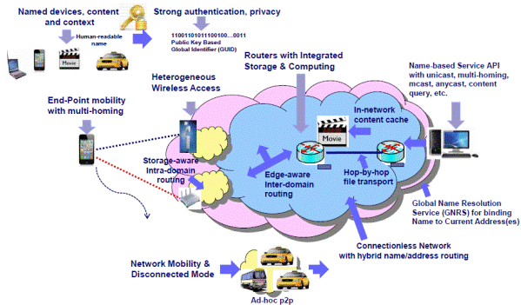
Mobility First
Members
Rutgers:
D. Raychaudhuri*+
Wade Trappe
UMass - Amherst
Arun Venkataramani#+
Jim Kurose
Umichigan:Z. Morley Mao+
Duke University: Xaiowei Yang+
MIT: Bill Lehr+
U Wisconsin
U Nebraska

Slide 66
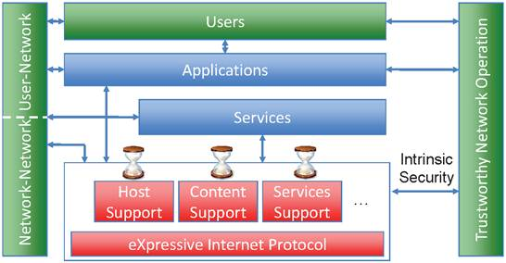
eXpressive Internet Architecture (XIA)
Aditya Akella - CS&S, UW-Madison
David Andersen - CS, CMU
Dan Barrett - CS, CMU (Senior Research Programmer)
John Byers - CS, BU
Laura Dabbish - HCII/Heinz, CMU
David Eckhardt - CS, CMU
Nitin Gupta - CS, CMU
Ruogu Kang - HCI, CMU
Sara Kiesler - HCII, CMU
Yanlin Li - CMU (Research Scientist)
Bruce Maggs - CS, Duke
Duyen Mary Nguyen, HCI, CMU (Post Doc)
Jon Peha - EPP/ECE, CMU
Adrian Perrig - EPP/ECE/CS, CMU
Raja Sambasivan - CS, CMU (Post Doc)
Marvin Sirbu - EPP/ECE, CMU
Chuck Song (Senior Scientist)
Srinivasan Seshan - CS, CMU
Peter Steenkiste (PI) - CS/ECE, CMU
Hui Zhang - CS, CMU

Slide 67
Named Data Networking (NDN)
Lixia Zhang, Deborah Estrin, and Jeffrey Burke
University of California, Los Angeles
Van Jacobson, James D. Thornton, and Diana K. Smetters
Palo Alto Research Center (PARC)
Beichuan Zhang
University of Arizona
Gene Tsudik
University of California, Irvine
kc claffy and Dmitri Krioukov
University of California, San Diego
Dan Massey and Christos Papadopoulos
Colorado State University
Tarek Abdelzaher
University of Illinois at Urbana-Champaign
Lan Wang
University of Memphis
Patrick Crowley
Washington University
Edmund Yeh
Yale University

Slide 68
The problem
ISP
ISP
Notes:
Current Internet architecture is communication- and comm. end-point-centric. But, the nature of the Internet shifted more towards content. Today’s Internet is radio-hostile; mobile-hostile; causes traffic concentration and congestion. It doesn’t deal well with distribution

Slide 69
Communication v. Distribution
 | Communication | Distribution
Naming | Endpoints | Content
Security | Secure Process | Secure Content

Slide 70
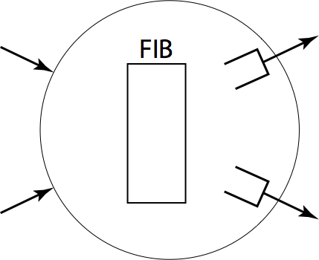
Today
X
dst
src
Path determined by global routing, not local choice
Structural asymmetry precludes market mechanisms and encourages monopoly formation
Notes:
Today’s internet routing has issues with being a distribution system. There are only a few mechanisms needing change to transform the current Internet from the worst to the best distribution system.

Slide 71
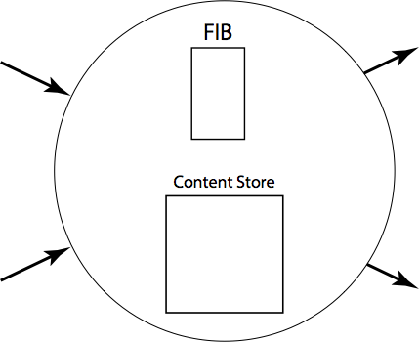
NDN approach
a/b
Producer
? a/b/c/e
Consumer
Packets say ‘what’ not ‘where’‘(no src or dst)
Forwarding decision is local
Upstream performance is measurable

Slide 72
We envision replacing this:
ISP
ISP

Slide 73
With THIS:
ISP
ISP
Notes:
Mobility is an issue with endpoint addresses, because they keep changing. In NDN, "Mobility is simply irrelevant” -- nothing associated with the communication changes with mobility.
Rather than naming the moving object (receiver) as in IP, we name the content desired by that object. Clearly things get delivered where you were – not where you are. If you move and simply request them again, you get them from a cache only one or two hops away, assuming incremental mobility.

Slide 74
Future Internet Architecture Next Phase (FIA-NP) Awards - 2014
Built upon success of FIA. Move from design to piloted deployments in real world setting.
No one architecture will replace Internet wholesale.
$15M total to 3 projects:
XIA-NP
Tests in vehicle network and large scale video delivery
NDN-NP – established industry consortium
Open mHealth and UCLA Facilities Management
Mobility First-NP
Wireless provider, content delivery network, weather emergency notification system

Slide 75
Group Discussions
Pls discuss the potential attacks towards different layers (physical/link layers, IP layers, transportation layers).

