Slide 1
Paul Marinescu*, Chad Parry*, Marjori Pomarole*, Yuan Tian ^, Patrick Tague ^, loannis Papagiannis* *Facebook, ^CMU
IVD: Automatic Learning and Enforcement of Authorization Rules in Online Social Networks

Slide 2
In a Nutshell
Defense in depth against authorization bugs

Slide 3
In a Nutshell
Patterns
Invariants
Blocked requests

Slide 4
Authorization Bug Example
Delete arbitrary videos

Slide 5
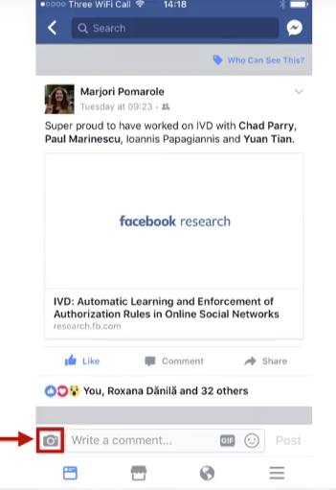

Slide 6
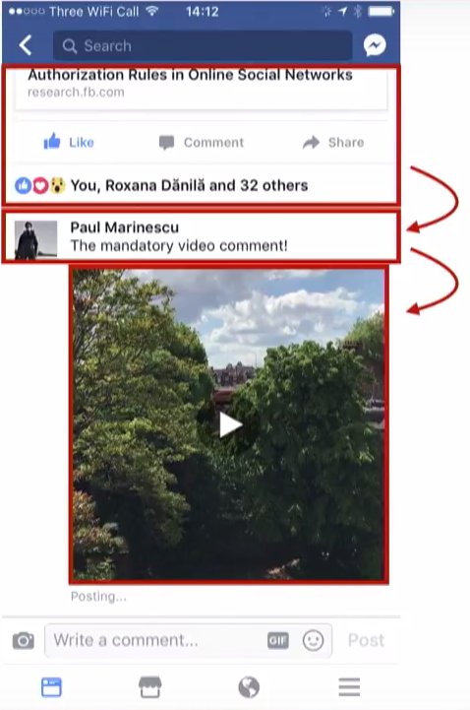
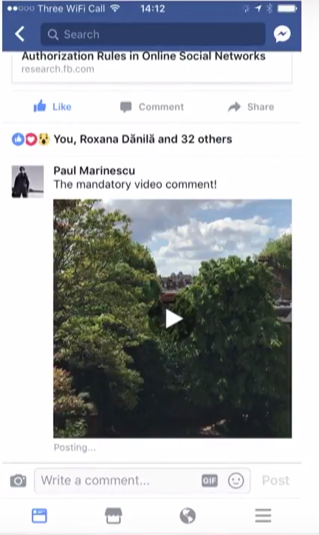
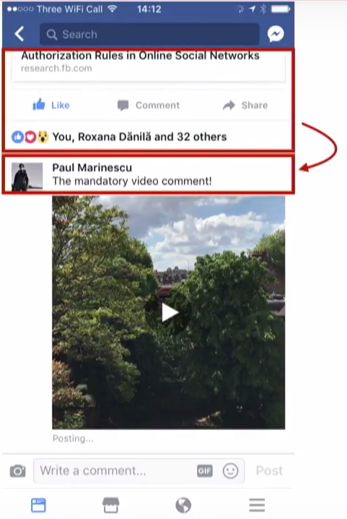

Slide 7
The Bug Fix
Only connect a comment with a video if they have
the same owner
Invariant

Slide 8
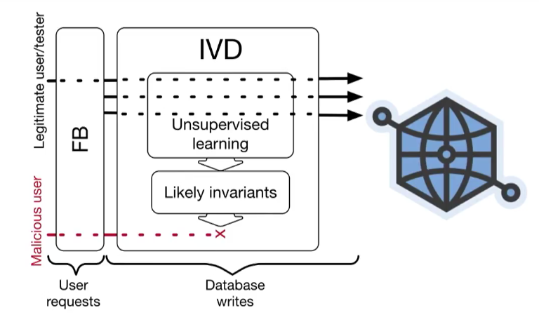

Slide 9
Scale

Slide 10
Scale
Trillions of graph entities
＞10 000 000 changes/second
＞200 000 invariants

Slide 11
At Scale Challenges
Runtime invariant checking overhead
Learning corpus size
Mitigating false positives

Slide 12
At Scale Challenges
Runtime invariant checking overhead
√Lightweight invariant design
Learning corpus size
Mitigating false positives

Slide 13
Invariant Design Goals
Invariants
Fast checking and enforcement
Tractable learning
Easy to understand

Slide 14
Invariant Design Insights
Invariants
In variants should mirror authorization rules
Authorization boils down to graph paths
Most authorization rules involve very short graph paths

Slide 15
Invariant Design
Existence of graph connections between:
Objects directly involved in the request
Properties of the objects directly involved
Global objects (logged-in user, their groups, pages, friends,…)
Invariants

Slide 16
Performance
CPU:0.014%
＜0.1ms overhead(p50)
＜0.5ms overhead(p99)

Slide 17
At Scale Challenges
Runtime invariant checking overhead
√Lightweight invariant design
Learning corpus size
√Two-step invariant learning
Mitigating false positives

Slide 18
Two-step invariant learning
Hundreds of billions of requests
Learning corpus
500 million

Slide 19
Two-step invariant learning
Hundreds of billions of requests
500 M
Invariants
under evaluation
Ratified Invariants
Learning
Evaluation

Slide 20
At Scale Challenges
Runtime invariant checking overhead
√Lightweight invariant design
Learning corpus size
√Two-step invariant learning
Mitigating false positives
√ Manual blacklisting, notifications
√ Enforcement excuses

Slide 21
Runtime Enforcement Excuses
Learning
Invariants
under evaluation
Ratified Invariants
Evaluation
Runtime
excuses
Blocked
Requests
Send
Notifications
Internal bots
Equivalent objects
Memorialized accounts
Workplace/Facebook differences
…

Slide 22
Enforcement
Excuses
False positives
Two-step invariant learning
Manual
blacklisting
Blocked
0.00004%
5 notifications/day

Slide 23
0.00000004% Overall false positive rate

Slide 24
Conclusion
Invariant detection is a
tractable defense in depth
technique at large scale
Mitigated actual bugs

Slide 25
Thanks

