Slide 1
The Price of Free: Privacy Leakage in Personalized Mobile In-App Ads
Wei Meng, Ren Ding, Simon P. Chung, Steven Han, Wenke Lee
College of Computing Georgia Institute of Technology
孟岩
2017.6.14

Slide 2
Outline
•
Background & Motivation
•
Methodology
•
Characterization of Mobile Ad Personalization
•
Privacy Leakage through Personalized Mobile Ads
•
Discussion
2

Slide 3
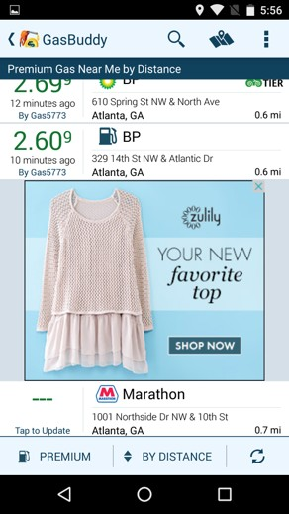
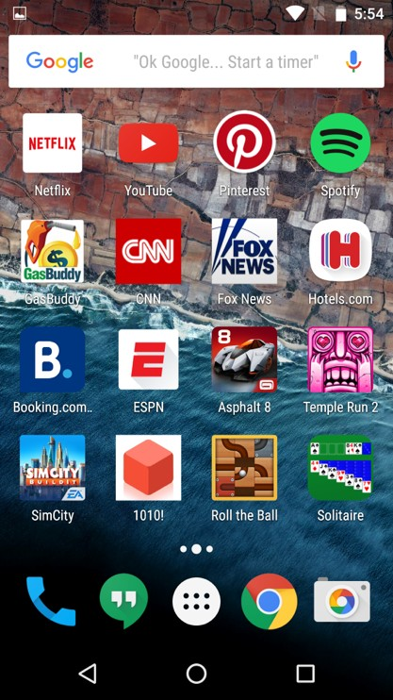
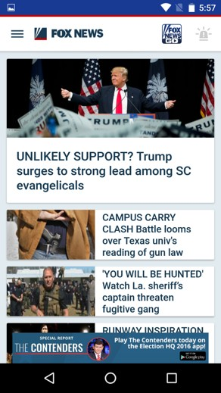
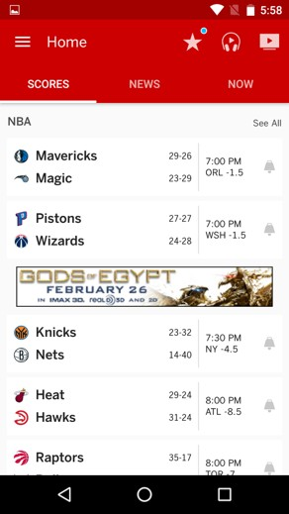
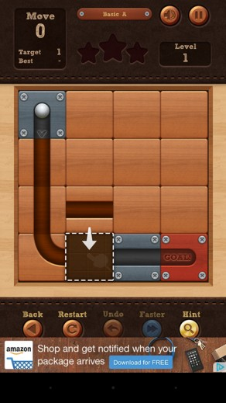
Mobile In-App Ad Ecosystem
$$$
$$$
Advertiser
$$$
Advertiser
$$$
Advertiser
}
Advertiser
Ad Network
Ad Request {User: XYZ, App: 003
Ad Request {User: XYZ, App: 074}
Ad personalized
for XYZ
Ad personalized
Ad Request {User: XYZ, App: 028}
for XYZ
$$
Ad Request {User: XYZ, App_{: 059}}
Ad personalized
Ad personalized
for XYZ
for XYZ
$$

Slide 4
Previous & Recent Work on Mobile Advertising
•
Targeting & personalization
[SmartAds (MobiSys’13), MAdScope (MobiSys’15)]
•
Privilege abuse by mobile ad libraries
[AdSplit (Security’12), AdDroid (ASIACCS’12), LayerCake (Security’13),
…]
One Origin Policy (Web Browser)
•
Fraud in mobile advertising
[AdSplit (Security’12), LayerCake (Security’13), DECAF (NSDI’14)]
•
Privacy-Preserving mobile advertising
[M. Götz, etc. (CCS’12)]
4

Slide 5
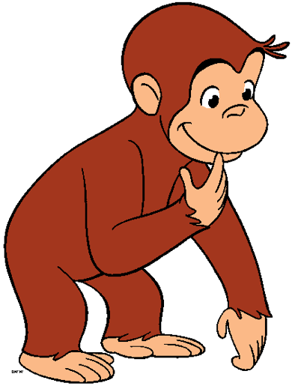
Mobile (Android) In-App Ad Ecosystem
$$$
$$$
Advertiser
$$$
Advertiser
$$$
Advertiser
Advertiser
Ad Network
Ad Request {User: XYZ, App: 028}
Ad Request {User: XYZ, App_{: 059}}
Ad personalized
Ad personalized
for XYZ
for XYZ
$$
$$

Slide 6
This Work
•
Characterizing mobile in-app ad personalization for real people
•
What personal information about real end users a dominate ad network such as Google know and use in personalized mobile advertising?
•
Estimating mobile app’s ability of learning about a user by observing personalized ads
•
Can an adversary with access to personalized mobile ads gain any information about real users?

Slide 7
Outline
•
Background & Motivation
•
Methodology
•
Characterization of Mobile Ad Personalization
•
Privacy Leakage through Personalized Mobile Ads
•
Discussion

Slide 8
Personal Information of Interest
•
Interest Profile
•
{Music, Games, Sports, …}
•
Demographics
•
Age, Gender, Education, Income, Ethnicity, Political Affiliation, Religion, Marital Status, Parental Status
https://support.google.com/adwords/answer/2580383?hl=en

Slide 9
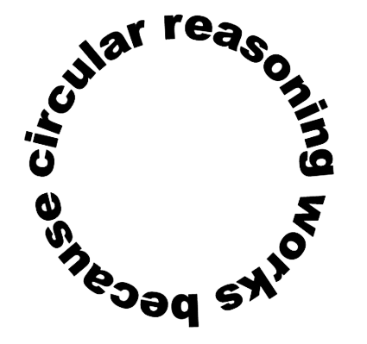
Challenges and Our Approaches
•
Triggering personalization based on target attributes of our interest
•
Using synthetic user profile is circular
•
Does ad network know users’ gender? ->
•
(We do not know how ad network knows users’ gender ->)
•
Let us build profiles for male and female users ->
•
Observation: Ads are not correlated with “gender” ->
•
Ad network does not use / know users’ gender. Really???
•
Our approach: Using profiles of real users

Slide 10
Challenges and Our Approaches (cont.)
•
Isolating personalization from other target attributes
•
Many attributes may affect ad personalization
•
App developers could provide target attributes through ad library APIs
•
Ads may be personalized based on user’s geolocation
•
Our approach: Collecting data in an isolated app

Slide 11
Ad Collection
•
Our “Mobile Ad Study” app
•
Connects user’s device to our VPN server (Isolating geolocation)
•
Serves Google AdMob ads only
•
Provides no target attributes through ad library API (Isolating other information, not including device information that ad library can access)
•
Collects the list of installed apps that include Google AdMob SDK

Slide 12
Subject Recruitment
•
Human Intelligence Task on Amazon Mechanical Turk
•
Complete questionnaire regarding participant’s interests and demographic information
•
Use our data collection app to load 100 ads from Google AdMob
•
We collected 217 valid responses from 284 participants

Slide 13
Subject Distribution
Gender |  | Political Affiliation |  |  | Parental Status |  | Income
Female | Male | Inde- pendent | Demo- crat | Repub- lican | Not a parent | Parent | < $30K | $30K- $60K | > $60K
95 43.78% | 122 56.22% | 108 49.77% | 80 36.87% | 29 13.36% | 128 58.99% | 89 41.01% | 107 49.31% | 67 30.87% | 43 19.82%
Religion |  |  | Marital Status |  |  | Education
Atheist | Non- Christian | Christian | Single | Married | Separa- ted | High school | Associa- tes | Bachelor | Master & Doctoral
83 37.79% | 47 21.66% | 88 40.55% | 124 57.14% | 73 33.64% | 20 9.22% | 78 35.94% | 50 23.04% | 71 32.72% | 18 8.30%
Age |  |  |  |  | Ethnicity
18-24 | 25-34 | 35-44 | 45-54 | 55+ | Other | Hispanic | Asian | African American | Cauca- sian
45 20.74% | 106 48.85% | 47 21.66% | 14 6.45% | 5 2.30% | 8 3.69% | 12 5.53% | 12 5.53% | 23 10.60% | 162 74.65%

Slide 14
Subject distribution (cont.)

Slide 15
Outline
•
Background & Motivation
•
Methodology
•
Characterization of Mobile Ad Personalization
•
Privacy Leakage through Personalized Mobile Ads
•
Discussion

Slide 16
Dataset
We collected 695 unique ads which resulted in 39,671 ad impressions delivered to 217 users
•

Slide 17
Interest Profile Based Personalization
Puser Pad
Beauty & Fitness
Finance
Home & Garden
Games
Art & Entertainment
Sports
•
Precision: |Puser ∩ Pad| / |Pad|
•
Recall:
|Puser ∩ Pad| / |Puser|

Slide 18
Interest Profile Based Personalization - Precision

Slide 19
Interest Profile Based Personalization - Recall

Slide 20
Demographics Based Personalization
•
We clustered users into different demographic groups
•
We tested the independence of ads and each demographic category
•
Pearson’s chi-squared test of independence
•
Null hypothesis: ad is independent of a demographic category
•
Significance level (P-value): 0.005
•
An ad is “personalized” based on the demographic category under test if null hypothesis is rejected

Slide 21
Demographics Based Personalization - Unique Ads

Slide 22
Demographics Based Personalization - Ad Impressions

Slide 23
Summary
•
Both interest profile based personalization and demographics based personalization were prevalent in mobile in-app advertising

Slide 24
Outline
•
Background & Motivation
•
Methodology
•
Characterization of Mobile Ad Personalization
•
Privacy Leakage through Personalized Mobile Ads
•
Discussion

Slide 25
Classification Models of Demographic Information
•
Features
•
Number of impressions of ads that are correlated with each demographic category
•
List of installed app that include Google AdMob SDK
•
Evaluation
•
217 samples were randomly divided into 5 sets for 5-fold cross validation
•
Metric for evaluating severity of privacy leakage
•
Cross validated accuracy (mean of accuracies of the 5 validations)
•
Adversary cannot have significant better accuracy than that obtained from tossing coins in a perfectly privacy-preserving system

Slide 26
Baseline Classifiers
•
Dummy
•
Assumption: samples are evenly distributed across labels
•
Predicts any possible label with same probability
•
Augmented Dummy
•
Assumption: samples are not evenly distributed
•
Knows the population distribution in prior
•
Always predicts the most popular label

Slide 27
Regrouping Subjects
•
Observation: Samples were not evenly distributed across all labels
Gender |  |  | Political Affiliation |  |  |  |  | Parental Status |  |  | Income
Female | Male |  | Inde- pendent |  | Non-Independent |  |  | Not a parent | Parent |  | < $30K |  | > $30K
95 43.78% | 122 56.22% |  | 108 49.77% |  | 109 50.23% |  |  | 128 58.99% | 89 41.01% |  | 107 49.31% |  | 110 50.69%
Religion |  |  |  |  | Marital Status |  |  |  | Education
Atheist | Non- Christian |  | Christian |  | Single |  | Not Single |  | High school |  | Associa- tes |  | Bachelor or higher
83 37.79% | 47 21.66% |  | 88 40.55% |  | 124 57.14% |  | 93 42.86% |  | 78 35.94% |  | 50 23.04% |  | 89 41.02%
Age |  |  |  |  |  | Ethnicity
18-27 |  | 28-33 |  | 34+ |  | Other |  | Hispanic |  | Asian |  | African American |  | Caucasian
71 32.72% |  | 71 32.72% |  | 75 34.56% |  | 8 3.69% |  | 12 5.53% |  | 12 5.53% |  | 23 10.60% |  | 162 74.65%

Slide 28
Evaluation Result
Age |  | Education Ethnicity |  | Gender | Income
Best | 0.54 | 0.40 | 0.76 | 0.74 | 0.62
Dummy | 0.33 | 0.33 | 0.20 | 0.50 | 0.50
Augmente | 0.35 | 0.41 | 0.75 | 0.56 | 0.51
d Dummy
Marital Status |  | Parental Status | Political Affiliation | Religion
Best | 0.63 | 0.66 | 0.59 | 0.43
Dummy | 0.50 | 0.50 | 0.50 | 0.33
Augmented | 0.57 | 0.59 | 0.50 | 0.41
Dummy

Slide 29
Outline
•
Background & Motivation
•
Methodology
•
Characterization of Mobile Ad Personalization
•
Privacy Leakage through Personalized Mobile Ads
•
Discussion

Slide 30
Privacy Implication
•
In Android, host app can observe all personalized ads
•
Ad network may be inadvertently leaking some of its collected user information (Age, Gender, Parental Status) to the app developer
•
Adversary also has non-trivial advantage in predicting other aspects of the user’s demographics
•
These aspects may be correlated with those collected and used by ad networks

Slide 31
Limitation
•
The size of our dataset is small
•
More aggressive adversaries may achieve significant better result
•
They can invest more resources to obtain better ground truth data
•
They can observe ads received by users for a longer period of time

Slide 32
Countermeasures
•
Root cause of the privacy leakage problem: lack of isolation between ads and host apps
•
Adopting HTTPS will not stop the problem
•
We really need isolation between ads and host apps
•
What can ad networks do?
•
Adding noise into personalized results
•
Providing coarser-grained targeting options

Slide 33
Summary
•
We collected both the profile and observed mobile ad traffic from 217 real users
•
We studied ad personalization based on real users’ interest profiles and demographics
•
We demonstrated that personalized in-app advertising can leak potentially sensitive information to any app that hosts ads

Slide 34
Thank you!
Q & A

