Slide 1
Presenter：张亦弛 2019-9-27
Review
ARNDroid: Adversarial Deep Learning for Robust Android Malware Detection

Slide 2
Outline
Summarization of the Paper
Novelty
Framework Explanation
Methodology of training
Evaluation Procedure
My Review
Summary
Strength
Weakness

Slide 3
Novelty
NetAED:
a defending mechanism (an altered Auto-Encoding Decoder) that can be used in front of any existing classifier

Slide 4
Framework: Architecture
Feature
Preprocessed feature
A trained classifier

Slide 5
Framework: Feature Extractor
 | Encoded as | Property
API Feature | Existing or not | Discrete
Permission Feature | Existing or not | Discrete
Method Opcode Feature | Frequency | Continuous
Shared Lib Method Opcode Feature | Frequency | Continuous

Slide 6
Framework: NetAED
5500
1000
2
1000
5500
1000
1000
A Stochastic Partially Destroying Mapping

Slide 7
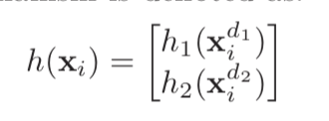
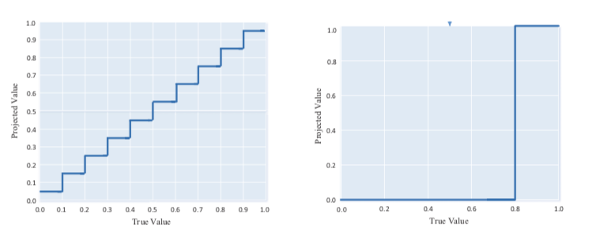
Methodology of Training: Apart from Training an AutoEncoder
Random Multi-Region Feature Perturbation
Discrete: Continuous:
Nonlinearity of discretization
Goodfellow: “Using more non-linear activation functions will be more resistant to adversarial perturbation.”

Slide 8
Evaluation
Dataset
Malware: Genome 1247, Drebin 5513, VirusSharem 20k
Benign: 25k from Play Store, validated by VirusTotal
Metric
Defense Performance: Recall(#Detected Malware)
Generation of Adversarial Sample for evaluation
Fast Gradient Sign Method: altered #feature = 10, 20, 30, 40, 50
Comparison
3 selected Baselines
“Adversary Resistant Deep Neural Networks with an Application to Malware Detection”
“A General Retraining Framework for Scalable Adversarial Classification”
“Distillation as a Defense to Adversarial Perturbations against Deep Neural Networks”

Slide 9
My Review
Paper Summary
In this paper, the authors propose ARNDroid framework which uses NetAED to be resistant to adversarially manipulated perturbation, in addition to an FFN to detect malware. NetAED is a new network architecture, which adds a purturbation layer before the input of an Autoencoder and a discretization layer after the input and output layer respectively. As claimed, the new framework can detect more adversarially manipulated applications than existed methods.

Slide 10
My Review
Overall: Likely Reject
Overall, this paper provides a novel idea on the general adversarial learning techniques. But in the field of malware detection, it has some weakness.

Slide 11
My Review
Strength:
1. Innovative thought and backward-compatible architecture
Using NetAED in addition with a formerly trained classifier can save huge amount of time for performing retraining.
2. Clear figures, tables and formula
Compared to other android malware detection paper, this paper includes enough mathematic equations to explain how the frameworks.

Slide 12
My Review
Weakness:
1. This paper lacks solidity in malware detection
i. Lack of explicit Definition of Malware
In this paper, the notion of Malware is not explicitly defined. Does it mean apps with actual “malicious behavior”? Or apps with sensitive apis or permissions that may be potentially used to conduct some “malicious behavior”? What kind of behaviors can be counted as “malicious”? Even though the benign apps are generated by a consensus of all the engines from VirusTotal, the authors are still suggested to summarize the explicit definition of malware. And it determines the very research target speaking of malware detection.

Slide 13
My Review
Weakness:
1. This paper lacks solidity in malware detection
The generation of adversarial examples only consider mutation on feature vector.
Mutation of the feature vector may omit necessary properties of an executable. While this approach is general — one can still get the representation of a runnable object — it cannot specifically guarantee all the adversarial sample may practically exist, thus exaggerating the gap between the proposed method and existed methods. Dealing with a highly structured representation like Dalvik bytecode, it requires more effort to mutate the code while keeping the object executable [2]. It is good that this aspect is discussed in the “Study Setup”, but it first lacks the validation that the adversarial examples still keep their malicious behaviors, and may exaggerate the gap by feature addition.

Slide 14
My Review
Weakness:
1. This paper lacks solidity in malware detection
The comparison in evaluation lacks persuasiveness
The defense performance of the proposed method does make sense. But the comparison with the baselines may fall into the Straw Man fallacy. Two thirds of the baseline models have no relation to malware detection. Using them as baselines may lack persuasiveness. Authors are suggested to refer to other adversarial learning methods specifically on malware detection, and as far as I know, there are many.

Slide 15
My Review
Weakness:
1. This paper lacks solidity in malware detection
The Feature Extractor may seem naive
In that part, the use of API feature and Permission feature is not explained in detail. Depending on an app’s category, these two characteristics can quite differ. The pure inclusion of sensitive APIs and more permissions cannot act as a direct proof. In addition, the frequency of opcodes may hardly help if it is used as proposed, because of the lack of control flow information such as when and where malicious action is called and how it is being controlled in the control flow graph[1].Traditionally, this information can be generated in two ways. Static analysis can approximate all the flow of instructions and dynamic analysis can dump the actual operation of a single flow. And extraction of this information may require more effort. In essence, using the features in a way as proposed in the paper seems naive to me.

Slide 16
My Review
Weakness:
2. The search on related works is not complete.
At the end of Introduction the contribution statement claims for unprecedentedness. However, simply conducting some search on Google Scholar by inputting “‘adversarial’ AND ‘android’” may print a list of papers with highly co-related topic. Admittedly, some of these papers only treat adversarial example in a program-analysis context. But there still ARE papers back to 2017 considers adversarial learning in addition with machine learning techniques, e.g. “Adversarial examples for malware detection” by K. Grosse, which has been cited by 100 times [2]. Although searching with “‘adversarial learning’ AND ‘android’” did give us nothing related. From this angle, it may imply the related works of this paper is not complete and gap is not well built.

Slide 17
My Review
Weakness:
3. Grammar mistakes
* In the abstract
“we propos a Random Multi-Region Feature Perturbation machanism and employe the non-linear discretization”. propos -> propose, employe -> employ
* in the introduction, paragraph 2
“which achieves impressed practical performance”, impressed -> impressive; “the existence ... degredes its appeal”, degredes -> degrades; :exploit the vulnerability to of models circumvent malware detection”, to of models circumvent -> of models to circumvent; “attacker can leverage feature ...”, attacker -> attackers
* and some more...

