Slide 1
Certified Robustness to Adversarial Examples with Differential Privacy s&p2019

Slide 2
Overview
Goal:
Give certified defense against adversarial examples.
Contributions:
Give proof of the certified defense
Show that it is an effective defense method during inference period.

Slide 3
Proof

Slide 4
Proof
Robustness definition

Slide 5
Proof
Expected Output Stability Bound

Slide 6
Proof
Bound

Slide 7
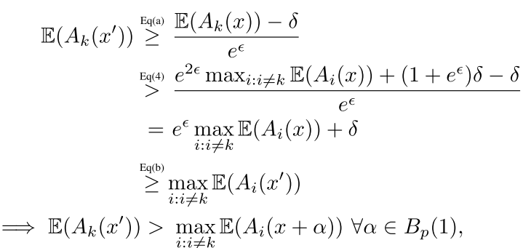
Proof
If it satisfies:

Slide 8
Experiments

Slide 9
Experiments

Slide 10
Limitation
The bound is not tight
It only using inference time smoothing to prove its bound. However, according to its experiment part, during training time it also uses the noise otherwise the classifier can not classify noisy instances correctly.
https://arxiv.org/abs/2003.08904
http://proceedings.mlr.press/v97/cohen19c/cohen19c.pdf

