Slide 1
What Are You Searching For? A Remote Keylogging Attack on Search Engine Autocomplete
John V. Monaco, Naval Postgraduate School
USENIX Security 2019
Presenter: Tang Ke
2020/2/28

Slide 2
Search engine autocomplete
Search query: Packet capture:

Slide 3
Attack overview
Predict search queries using only client traffic
Combine multiple independent weak predictors
Escaped URL characters
HTTP2 header compression
Key-press time intervals
Natural language

Slide 4
Threat model
Capture encrypted traffic at the NIC
Victim types lowercase English letters + Space
No typos/backspace
Autocomplete requests triggered by keydown events

Slide 5
Attack workflow
Time
(
Packet trace
)
Keystroke detection
Tokenization
and
0.2
lazy
0.1
cat
Dictionary pruning
are
0.1
onto
dog
0.3
the
0.4
that
0.3
fox
0.2
Word identification
the lazy dog
the lazy fox
Beam search
and that dog

Slide 6
Autocomplete GET requests

Slide 7
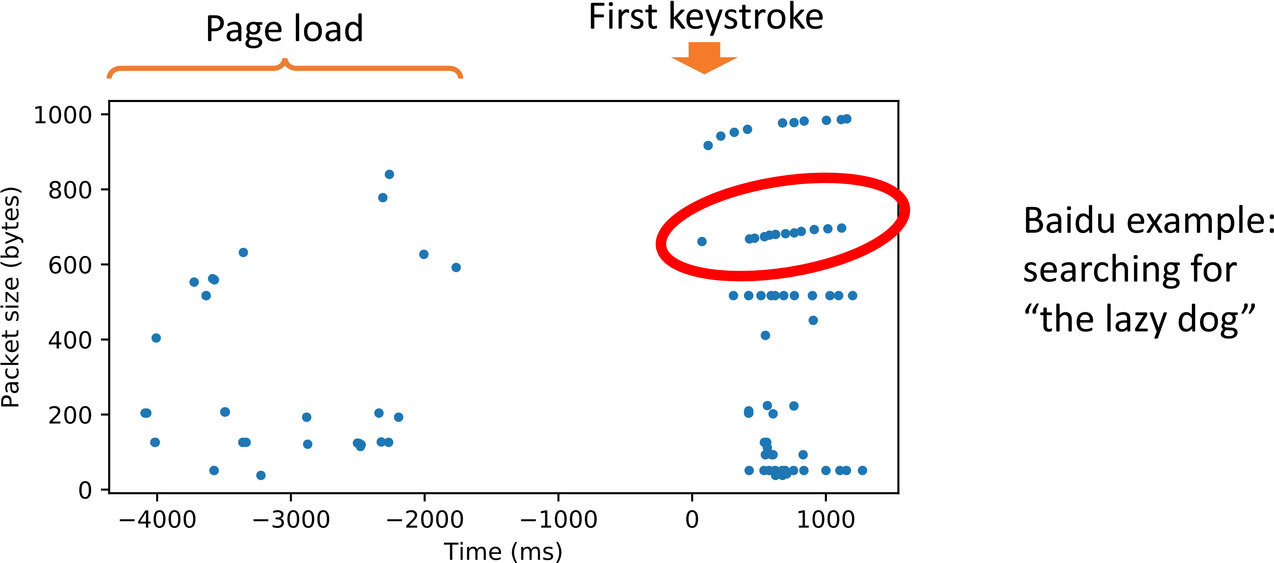
Keystroke detection
Find the longest increasing subsequence (LIS) of packet sizes

Slide 8
Tokenization
Packet size difference
GET /complete/search?q=t&cp=1
GET /complete/search?q=th&cp=2 +1
GET /complete/search?q=the&cp=3 +1
GET /complete/search?q=the%20&cp=4 +3
GET /complete/search?q=the%20l&cp=5 +1
GET /complete/search?q=the%20la&cp=6 +1
GET /complete/search?q=the%20laz&cp=7 +1
GET /complete/search?q=the%20lazy&cp=8 +1

Slide 9
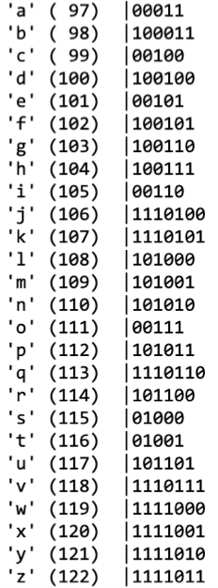
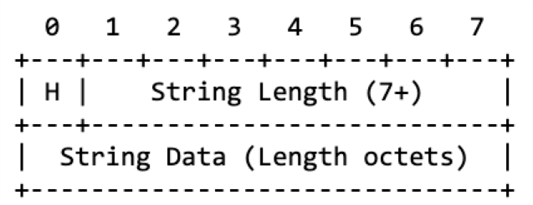
HPACK (HTTP2 header compression)
Static Huffman Encoding

Slide 10
PETAL (Preset Encoding Table Information Leakage)

Slide 11
Incremental compression

Slide 12
Dictionary pruning

Slide 13
Word identification
D
O
G
S
Packet
arrivals
Short
Short
Long
Time
•
Use a
BiRNN
to predict keys

Slide 14
Language model and beam search
Which word comes next?
> the lazy ____
1) dog
2) car
3) hat
4) big
Top 50 hypotheses:
the lazy dog
the blue car
and some fox
…
how they run

Slide 15
Data collection and results
Data collect
Browser automation with Selenium
Replay keystrokes with uinput
4k unique queries
2 search engines (Google, Baidu)
2 browsers (Chrome, Firefox)
16k total queries recorded
Keystroke detection and tokenization accuracy
> 99% (Google and Baidu)
Top-50 classification accuracy (entire query is correct)
15% (Google)
13% (Baidu)
Example
Truth
he is recovering from a sprained
Good hypotheses
he is recovering from a sprained he is recovering from a strained
Bad hypotheses
to be president from a position is to learn from such a position

Slide 16
Conclusions
This attack has many of moving parts…
Several independent weak side channels combine to create a strong one
Language modeling is key
The predictability of human behavior is difficult to mask
Where else does incremental compression occur?
Thin clients/websites with autosave feature?
Mapping services (latitude/longitude changes incrementally)?

Slide 17
Thank you
Source code
kreep (keystroke recognition and entropy elimination program) https://github.com/vmonaco/kreep
Contact the author
https://vmonaco.com

