Slide 1
DNS Cache Poisoning Attack Reloaded: Revolutions with Side Channels
Keyu Man, Zhiyun Qian, Zhongjie Wang,
Xiaofeng Zheng†, Youjun Huang†, Haixin Duan†
†
CCS 2020 Best Paper Award

Slide 2
Contents
Background
DNS Cache Poisoning
Part I: Infer Ephemeral Port
Part II: Extend Attack Window
Our Attacks
Defenses
Conclusion

Slide 3
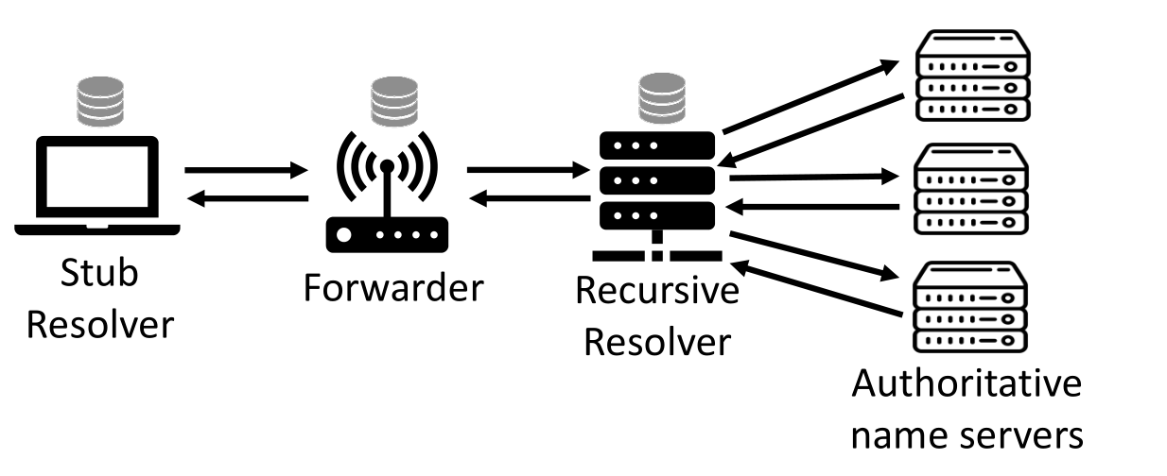
DNS

Slide 12
DNS Cache Poisoning
www.bank.com IP=6.6.6.6
Resolver
5.6.7.8
Trudy (Off-path)

Slide 13
DNS Cache Poisoning
www.bank.com IP=6.6.6.6
Resolver
5.6.7.8
Trudy (Off-path)
IP Layer | Src: 5.6.7.8
 | Dst: (resolver)
UDP Layer | Src Port: 53 | Dst Port:
DNS Layer | TxID:
 | Question: www.bank.com A ?
 | Answer: www.bank.com A 6.6.6.6, TTL=99999
? (16 bit)
? (16 bit)

Slide 14
DNS Cache Poisoning
www.bank.com IP=6.6.6.6
Resolver
5.6.7.8
Trudy (Off-path)
IP Layer | Src: 5.6.7.8
 | Dst: (resolver)
UDP Layer | Src Port: 53 | Dst Port:
DNS Layer | TxID:
 | Question: www.bank.com A ?
 | Answer: www.bank.com A 6.6.6.6, TTL=99999
? (16 bit)
? (16 bit)
Ephemeral Port=Client Port Q:12345->53
_{Resolver} R:53->12345 | NS

Slide 15
DNS Cache Poisoning
www.bank.com IP=6.6.6.6
Resolver
5.6.7.8
Trudy (Off-path)
IP Layer | Src: 5.6.7.8
 | Dst: (resolver)
UDP Layer | Src Port: 53 | Dst Port:
DNS Layer | TxID:
 | Question: www.bank.com A ?
 | Answer: www.bank.com A 6.6.6.6, TTL=99999
? (16 bit)
? (16 bit)
Ephemeral Port=Client Port Q:12345->53
_{Resolver} R:53->12345 | NS

Slide 16
DNS Cache Poisoning
www.bank.com IP=6.6.6.6
Resolver
5.6.7.8
Trudy (Off-path)
IP Layer | Src: 5.6.7.8
 | Dst: (resolver)
UDP Layer | Src Port: 53 | Dst Port:
DNS Layer | TxID:
 | Question: www.bank.com A ?
 | Answer: www.bank.com A 6.6.6.6, TTL=99999
? (16 bit)
? (16 bit)
Ephemeral Port=Client Port Q:12345->53
_{Resolver} R:53->12345 | NS
Traditional: 2¹⁶ × 2¹⁶ = 2³² (Impossible in short time)
Our Side Channel: 2¹⁶ + 2¹⁶ ≈ 2¹⁶

Slide 17
DNS Cache Poisoning
www.bank.com IP=6.6.6.6
Resolver
5.6.7.8
Trudy (Off-path)
IP Layer | Src: 5.6.7.8
 | Dst: (resolver)
UDP Layer | Src Port: 53 | Dst Port:
DNS Layer | TxID:
 | Question: www.bank.com A ?
 | Answer: www.bank.com A 6.6.6.6, TTL=99999
? (16 bit)
? (16 bit)
Ephemeral Port=Client Port Q:12345->53
_{Resolver} R:53->12345 | NS
Traditional: 2¹⁶ × 2¹⁶ = 2³² (Impossible in short time)
Our Side Channel: 2¹⁶ + 2¹⁶ ≈ 2¹⁶

Slide 18
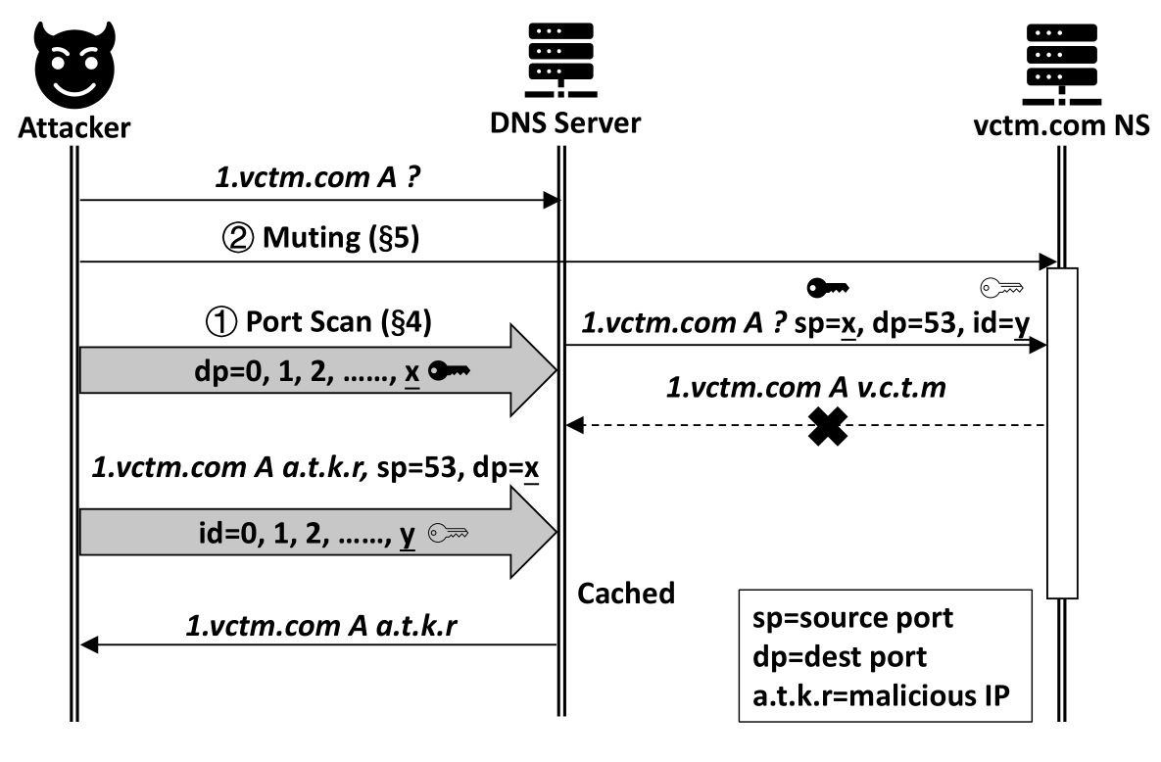
Attack workflow

Slide 19
Contents
Background
Part I: Infer Ephemeral Port
Side-channel-based Scan
Part II: Extend Attack Window
Our Attacks
Defenses
Conclusion

Slide 20
Port Inference: Basics
Resolver
Attacker
OS
APP
Listen on 53
UDP dport=53
Packet
UDP dport=67
ICMP: 67 isn’t open

Slide 21
Port Inference: Ephemeral Ports
Attacker
Resolver
Nameserver
DNS Query
(Ephemeral Port) 1234->53
UDP dport=1234
UDP dport=1234
ICMP: 1234 isn’t open

Slide 22
Port Inference: IP Spoofing
5.6.7.8
Attacker
Resolver
5.6.7.8
Nameserver
UDP dport=1234
UDP dport=5678
ICMP: 5678 isn’t open

Slide 23
Port Inference:
Side Channel

Slide 24
Port Inference:
Side Channel
ICMP Global Rate Limit:
Limit sending rate
Shared by all IPs
50 ICMPs / 50 ms
Off-Path TCP Exploits: Global Rate Limit Considered Dangerous
USENIX Security 2016
9

Slide 25
Port Inference:
Side Channel
ICMP Global Rate Limit:
Limit sending rate
Shared by all IPs
50 ICMPs / 50 ms
Off-Path TCP Exploits: Global Rate Limit Considered Dangerous
USENIX Security 2016
9

Slide 26
Port Inference: How It Works
Resolver
with NO port open
Nameserver
Attacker
Resolver
with ONE port open
Nameserver
Attacker
Counter=50
Counter=50
50 UDP Probes
Hit 49 closed ports &
1 open port
50 UDP Probes
Hit 50 closed ports
50 ICMPs
49 ICMPs
Counter=50-50=0
Counter=50-49=1
Verification
Verification
Spoofed
ICMP Reply
Normal

Slide 27
Port Inference: Measurement

Slide 28
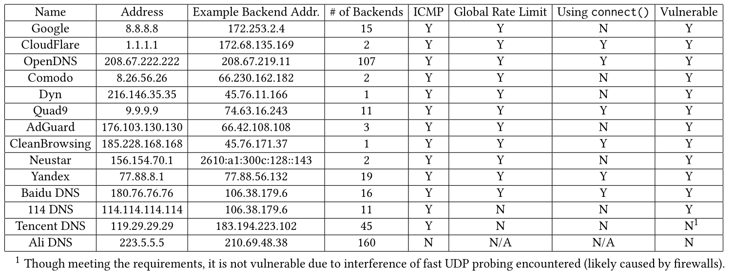
Port Inference: Measurement
Well-known Public Resolvers:
12/14 Vulnerable
Open Resolvers:
34% Vulnerable

Slide 29
Contents
Background
Overview
Part I: Infer Ephemeral Port
Part II: Extend Attack Window
Strategy I: Malicious Name Server (Refer to the Paper)
Strategy II: Response Rate Limiting
Our Attacks
Defenses
Conclusion

Slide 30
Extend Attack Window
Query
Que
ry
Attack
Window
Fake
Response
Flooding
Resp
onse
Queries

Slide 31
Extend Attack Window
RRL: 18%
Deployed
Query
Que
ry
Attack
Window
Flooding
Queries
Respo
nse

Slide 32
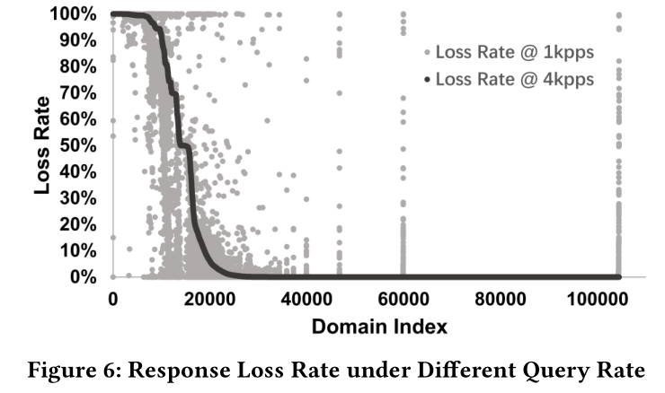
Extend Attack Window

Slide 33
Contents
Background
Part I: Infer Ephemeral Port
Part II: Extend Attack Window
Our Attacks
Forwarder Attack
Resolver Attack
Defenses
Conclusion

Slide 34
Forwarder Attack: Results
Device: Xiaomi R3 Wi-Fi Router
Upstream DNS server: 1.1.1.1
Success rate: 20/20
Average time-to-succeed: 271s

Slide 35
Contents
Background
Part I: Infer Ephemeral Port
Part II: Extend Attack Window
Our Attacks
Forwarder Attack (Refer to the Paper)
Resolver Attack
Defenses
Conclusion

Slide 38
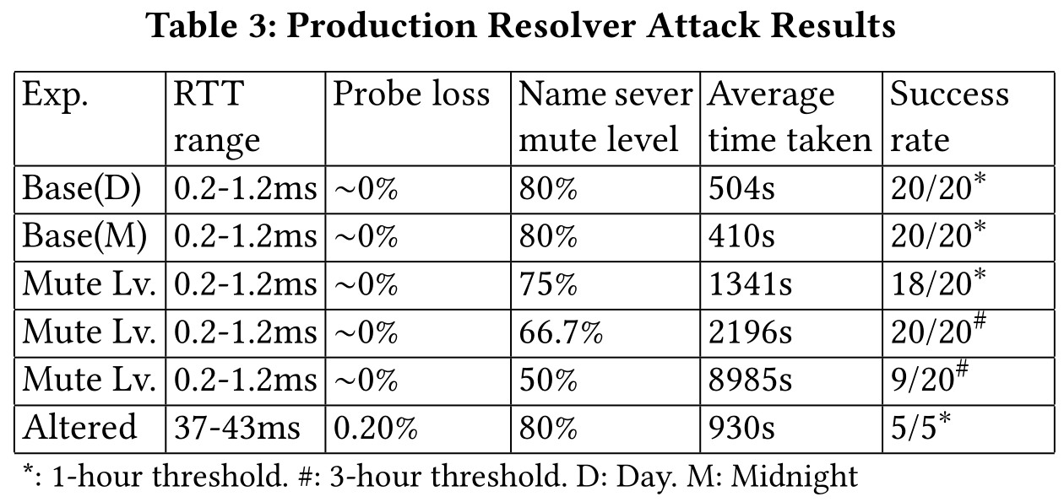
Resolver Attack: Results

Slide 39
Contents
Background
Part I: Infer Ephemeral Port
Part II: Extend Attack Window
Our Attacks
Defenses
Conclusion

Slide 40
Defenses
DNSSEC
0x20 encoding
DNS cookie
Only 5% open resolvers deployed
Disable ICMP port unreachable
Randomize ICMP global rate limit

Slide 41
Contents
Background
Part I: Infer Ephemeral Port
Part II: Extend Attack Window
Our Attacks
Defenses
Conclusion

Slide 42
Conclusion
Side-channel-based UDP port scan.
Make DNS cache poisoning possible again!
Real-world attacks.

