Slide 1
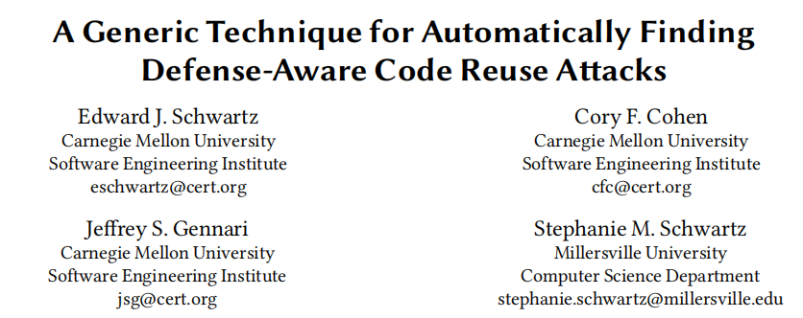

Slide 2
Attack-Defense-Attack

Slide 3
Bacground: Shellcode
Memory
movl $42, 0x8048423
Stack
Library Code
Heap
Program Code

Slide 4
Background: Data Execution Prevention(DEP)
Goal:
Prevent attacker from inserting executanle code into memory (for the expolit's computation)
Implementation:
Memory should never be writeable and executable at the same time

Slide 5
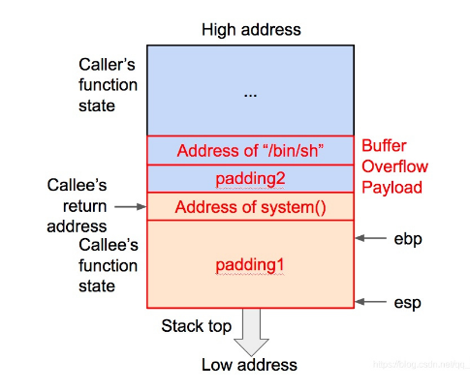
Bacground: Code Reuse Attacks
Memory
movl $42, 0x8048423
Stack
Return2libc
Library Code
Heap
Program Code

Slide 6
Background: Code Reuse Attacks
Return Oriented Programming (ROP)
ROP < Code Reuse
Find gadgets, code sequence ending in ret, that perform useful actions
JOP(Jump) COP(Call) DOP(Data--heartbleed)

Slide 7
Modern Code Reuse Attack
ASLR(Address Space Layout Randomization)
Defenses designed to protect against code reuse attacks.
no ret ------> jmp/call
CFI(Control Flow Intergrity): Determine valid control flow transitions at compile time and prevent invalid transitions at run time.
coarse-grained
fine-grained
Defenses: Substantially Less Code Available for Reuse

Slide 8
Existing Work in Automating Code Reuse Attacks
Existing Work is Hard-coded to Specific Configuration
System | DEP(Only) | CFI | Generic Defense
traitor Roemer 2009 | YES | NO | NO
Kornau 2009 | YES | NO | NO
Q Schwartz 2011 | YES | NO | NO
Wollgast 2016 | YES | YES(coarse-grained) | NO
BOPC lspoglou 2018 | NO | YES(fine-grained) | NO
Our Goal | YES | YES | YES

Slide 9
What is a code reuse attack?
A code reuse attack is a program execution:
That respects DEP
Starts from a specific vulnerability
Different vulnerabilities yield different amounts of control over the program state
Reaches a goal state
Depends on the attacker's goals
Spawning a shell or writing a particular value to memory
Software Model Checking(SMC)

Slide 10
Is the error state reachable from the entry point?
Is the goal state reachable from the vulnerabiolity?

Slide 11
The Big Idea
Cast code reuse attacks as a software model checking problem and solve it using an exising technique

Slide 12
Limbo
We created a prototype call Limbo based on these ideas.
Reasons about code reuse attacks in a very general way
Because it searches based on reachability
Other automated techniques implement a predefined strategy
Can search for attacks even in the presence of unknown defenses
Implementation of defense must be observable
Built on top of ForAllSecure's Mayhem concolic executor
Helps solve the software model checking problem.

Slide 13
Concolic Execution
Starting State:
Provide a concrete test case that triggers a control flow vulnerability
Specify a starting state that is a concrete test case that does not trigger a vulnerability
Elect to employ a synthetic buffer overflow vulnerability.
Goal State:
Specify goal states by providing a goal expression,which may reference register and memory values. For example, “%eax==0xd34db33f” or “M[0x12345678]==0xd34db33f”
Exploring Reachable States:
Concolic execution represents states symbolically.

Slide 14
Background: Concolic Execution
Dynamic analysis: finding a particular execution is infeasible
Static analysis: low precision
Middle ground: Concolic Execution
Dynamic
reason about one program path at a time

Slide 15
Concolic Execution Search Heuristics
The search space is large so we use heuristics to guide execution to more promising execution paths
Limbo would get “stuck” exploring complex functions
Prefer states with more symbolic control
mov %eax, (%ebx) with concrete vs. symbolic operands
Award +1 point for each symbolic bit in a register
Award +1 point for each symbolic memory byte located in the scratch storge area
Prefer a smaller state space
Each indirect jump significantly increases the size of the state space
First symbolic indirect jump is charged 3*n where n is pointer width
Subsequent symbolic indirect jumps are only charged n

Slide 16
Research Questions
RQ1: Can Limbo discover code reuse attacks in the presence of fine-grained CFI?
RQ2: How much executable code does Limbo require to produce code reuse attacks?
RQ3: How sensitive is Limbo to its heuristics?
RQ4: Can Limbo discover new techniques?

Slide 17
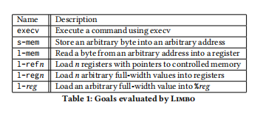

Slide 18
RQ1: Can Limbo discover code reuse attacks in the presence of fine-grained CFI?
Comapred with BOPC
(BOP Compiler,自动化生成图灵完备的数据流payload的工具)

Slide 19
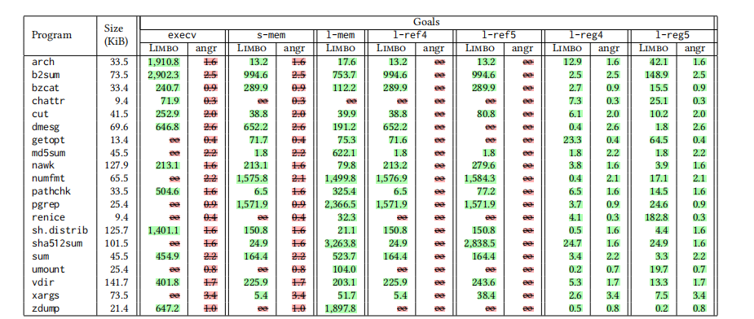
RQ2: How much executable code does Limbo require to produce code reuse attacks?
Compare with angrop(angrop is a rop gadget finder and chain builder)

Slide 20
RQ3: How sensitive is Limbo to its heuristics?

Slide 21
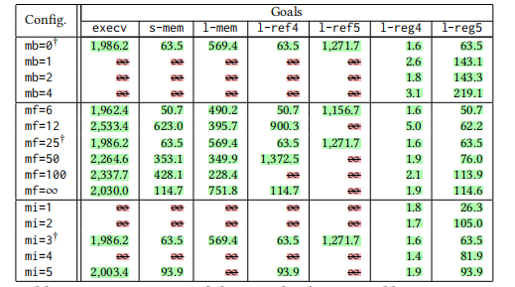

Slide 22
RQ4: Can Limbo discover new techniques?
.To answer this question, we examine in detail an attack that Limbo found in tput (9.6 KiB) for the s-mem goal. In tput, this goal attempts to write 42 to address 0x804b000.

Slide 23
Limitations
Inherited by concolic executionn
Constraints take too many resources to solve
Path explosion problem
Mitigated by Limbo's heuristics
More of a problem on larger program, complex goals.
Implementation
Mayhem only supports 32-bit Linux executables
Limbo's heuristics are designed to be platform agnostic
We have a post-publication prototype in angr that is multi-platform

Slide 24
Conclusion
Cast code reuse attacks as a software model checking problem
Can reason about defenses
Does not use a fixed strategy
Very computationally expensive
Performs better on smaller programs

